Slide 1
Toreros en España
https://www.youtube.com/watch?v=Z6oy1Fqgm1c

Slide 2
Vocabulario Taurino
Toro- Bull (an Iberian cattle breed)
Novillos-Novillos bulls younger than three years some don´t pass bravery or stamina test to to become first rate fighting bulls. These bulls are used in novilladas to train novilleros.
Corrida de toros: A public spectator bullfighting event which occurs in a bullfighting ring. Normally three bullfighters confront 3 bulls each in a corrida.
Vaquillas/ Novillas: female wild cow of the same breed as the fighting bulls between two and four years old. They are typically used in place of fighting bulls or novillos for capeas or encierros in village celebrations because they are much smaller and less likely to cause grave damage.
Matadores: Matador de toros literally translated as "bull killer" is the professional level of a bullfighter.
Mozo de espada: The matador‘s assistant or "sword page." The mozo de espada prepares and hands the matador all the equipment necessary during the corrida.

Slide 3
Vocabulario Taurino
Lidiar /Torear: Verb "to bullfight" until death
Muleta: small red cape used in the third stage of the Spanish bullfight
Paseíllo: A parade of all the toreros around the arena before a corrida.

Slide 4
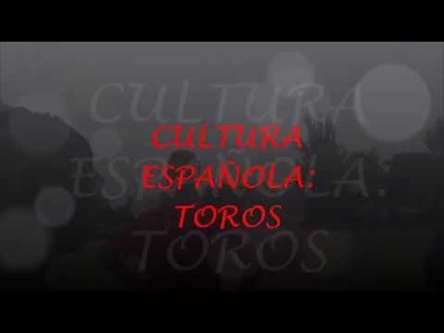
Tradición español

Slide 5


Slide 6
Discuss the perception people have of bullfighting.
Do a questionnaire in Spanish with your classmates to find out what people think about this Sport.

Slide 7
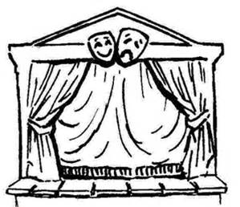
Role- PLAY
En pareja
Personaje 1 es un torero apasionado
Personaje 2 es defensora de los derechos animales
Prepara un guión para la escena

