Slide 1

Language Communities, OERs and open practice
Kate Borthwick
Centre for Languages, Linguistics and Area Studies
University of Southampton, UK
OER and Languages, Open Education Week, March 2013
@Kborthwick @LLASCentre @elearnLLAS
LLAS
Centre for Languages, Linguistics and Area Studies
University of Southampton
Southampton, SO17 1BJ
+44 (0) 23 8059 6860 | @LLASCentre | www.llas.ac.uk
Notes:
Hello, I’m Kate Borthwick and I am an academic coordinator for elearning at the Centre for Languages, Linguistics and Area Studies. The Centre for LLAS is based within the University of Southampton, and we are a research and enterprise group which supports and promotes the teaching and learning of languages in all educational sectors. We provide professional development events, resources and engage in research at national and international levels aimed at promoting the learning of languages. I’m going to talk about some of the projects that we have led within the language teacher community, related to OERs and open practice, and some of the other community groups and support services and resources out there on the web.

Slide 2
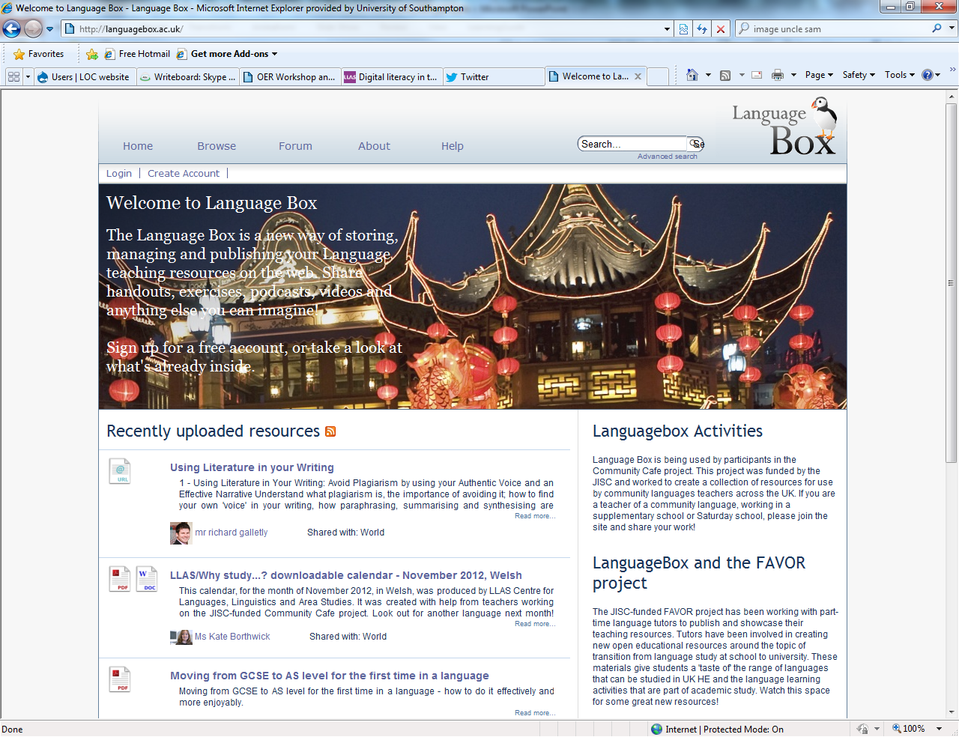

Notes:
At LLAS, we have been involved – for the last 5 years - in projects which have looked at different aspects of open practice.
Early projects that we were involved in looked at creating the ‘perfect’ teaching and learning repository – ie. a good place to share teaching resources. These projects were fairly technical in focus – creating a site Language teachers liked, removing technical barriers to engagement, considering formats for sharing, the varied technicalities of the sites themselves. At this point in time, the technical outweighed other considerations on open practice – such as how and why practitioners would engage with it, pedagogical value, value to academic practice, implications for teaching, for students and so on.
These projects led to the creation of the repository, the LanguageBox. This site was the result of an evolution over time of different repositories which changed in response to user comments and feedback – from language teachers. So it was very much built with input from the language teaching community. You will recognise the site – the basic platform has gone on to be used by other repositories – LORO is an evolution of the platform. LanguageBox still exists and is used by a global community that grows all the time and includes school teachers, HE teachers and a wide range of languages from MFL to community languages.

Slide 3
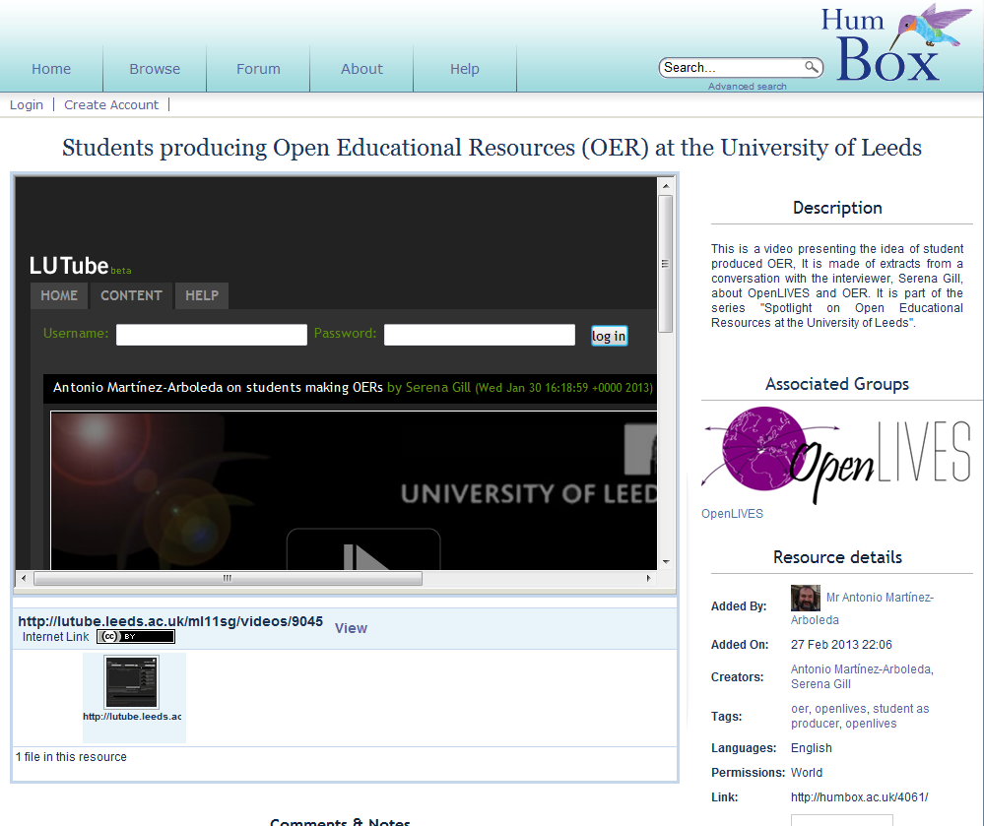
Notes:
So having built a website that we liked and wanted to use for sharing, our later open practice projects sought to explore what open practice might mean for humanities academics and language tutors.
Our first open practice project was called HumBox and it was a collaboration between 11 different humanities departments across the UK: the project aimed to encourage sharing of educational resources amongst different humanities practitioners – including language educators – and this website – the HumBox, was the focus for this activity. The HumBox is actively used today by a small, active community of contributors and many thousands of browsers. It contains a range of resources on all sorts of humanities-related subjects including philosophy, history, English, languages. It is a community site which is very much owned and driven by its user community – anyone can register on it.
You can see that it is also possible to create groups – like special interest groups – and to upload resources as part of a team or designated interest group. This particular one has been uploaded as part of the OpenLIVES team, a Spanish language OER project, which I’ll talk more about in a moment.

Slide 4
HumBox findings
Academic practice enhanced through engagement with open working:
Digital literacy
  publishing work openly (copyright, formats etc)
  online public profile for teaching
  contact with new, unexpected audiences
  adoption of new ideas/approaches from viewing work of others
Notes:
The project which created HumBox and its community was an amazing one – and it is heartening to see the site going from strength to strength today. It is a site driven by its community of teachers. I think this ongoing activity is because HumBox users became champions for Open practice. They found that they enjoyed open working – and they enjoyed it because their academic practice was actually enhanced through engaging with it. And focussing particularly on digital literacy, they fed back to us that the project enhanced what they do in several ways:
Digital literacy – publishing work openly – when participants in the project were considering what to publish, they had to consider format of the resource (to be shareable); content (was it too institution or context-specific to have meaning to others); metadata (how to stand back from their resources and describe them so that others would understand them and know how to use them); they had to identify shareable aspects of the resource which may not be related to content (approach, idea, ped. Method), and they were forced to reflect on the content and quality of their own work because it would be public.
Using the HumBox also demanded the creation of an online profile which could showcase teaching work and also link research and teaching – this encouraged our Humboxers to think about their digital footprint and their online profile in general – something that becomes increasingly relevant and important
Through the project they made contact with other audiences – new and unexpected audiences and this conveyed an understanding of how academic work can have new life in the online environment
Humboxers also gained new ideas/approaches from others especially in innovative use of IT – and they got these ideas through reviewing and looking at the work of others, also published openly via the project
So there was a lot learnt and a lot of benefits felt through working on the project – and engaging with open practice. And actually, all of these activities are within the comfort zone of usual academic life (having a public profile for work; offering work for peer review, and reflection on pedagogical practice). So I think ultimately, this HumBox project was about a group of academic practitioners getting their heads around OERs and exploring how it fits with what they do everyday: project participants were revising their understanding of existing processes - but in a new context. The newness of ‘open’.

Slide 5

Challenges:
CBLTs work in isolation; out-of-hours; in informal situations
Reliant on own materials
Few opportunities to meet fellow teachers and share practice
Lack of professional development or opportunities
Low level use of digital resources in teaching
Impact:
Practical aspects to the project had a greater impact (e.g. training)
Teachers had no problem with the idea of ‘open’
They use their new skills in teaching
Increased willingness to reflect on teaching
Notes:
We took our improved understanding of open practice to our next project: we knew we had a repository which worked and we had a better understanding of how open practice could benefit teachers and have an impact on working in a digital world.
Our next project worked with Community-based language teachers teaching outside mainstream situations. We were essentially aiming to do similar things as in the HumBox project: get community-based teachers to share resources on an open site. We worked with Southampton City Council and Manchester Met Uni. On the JISC-funded Community Café project. We faced different challenges.
Different challenges (see slide). They seemed like a group that could benefit from working on an open practice project - increased access to resources; sharing practice and ideas in an online community and importantly, improved digital literacy in their working lives.
Impact similar and more direct – practical aspects of the project had a great impact – teachers were enthusiastic to learn about open practice and the issues surrounding it and digital resource creation. They had no qualms about sharing their materials with the world – they just wanted the tools to do it. So rather than having conceptual fears and doubts (like the HB group), they were interested in the practicality of the ‘how’.
They make use of the new skills in their teaching and their coordinator has also seen an impact in their willingness to talk to each other and reflect on their teaching.
So with this project, we saw how the focus of open practice could be a vehicle for the acquisition and absorption of new skills.

Slide 6
The FAVOR project
Finding A Voice through Open Resources (JISC)
Part-time, hourly-paid language tutors
Sharing existing resources
Creating new transition resources for prospective university applicants: ‘taste of’ new languages; language study at HE
Collaboration: 5 UK universities
Notes:
The idea that open practice could be a vehicle for improving practice and enhancing digital literacy and digital practice was something we actively explored in our next project – a project which has only just concluded.
The FAVOR project was funded by JISC again and it worked with part-time, hourly-paid tutors to do two things: the first phase was to publish and share existing teaching resources as open content to build up a public, professional profile. The second phase was for the tutors to create ‘transition’ materials for prospective university students – these would be new OERs designed to assist potential students in understanding how languages are taught in HE, and to give a taste of some of the new languages that can be studied at HE level but not in school. The project was a collaboration between tutors at 5 UK universities– and we’ve been able to put over 300 new resources onto the LanguageBox which introduce new learners to languages.

Slide 7
FAVOR: findings
Enhanced practice
- new skills acquired: “I’ve learnt a lot. I say thank you very much for the project because for me it was great…now I’m so motivated to learn more.”
- enhanced confidence: “I know that now, I am more confident in creating my own resources, so I know…I can go and do it faster and more efficiently”
- improved practice through self-reflection and improved digital literacy
Increased feeling of ‘belonging’ via public profile and association to institution
Change of practice
- New approaches and skills adopted; motivation to try out new methods
Sustainability
- use with students and long-lasting impact on teaching
“open practice is a way to work as a teacher, sharing not only resources but ideas, opinions with other teachers and learn from each other.”
Notes:
And so it has been the case. We have just finished an evaluation process which has looked at the impact of the project on tutors and it has become clear that open practice has once again acted as a vehicle to enhance practice:
Tutors had found that working on the project had enhanced what they do:
They had acquired new skills in the use of different technologies for teaching. This new knowledge had either come through training workshops or through looking at the shared work of their peers and gleaning ideas from it.
Preparing their work for open publication had also led them to reflect on their work, the content, the quality, how it might be shared by others
They reported increased confidence in their resources because peer feedback was positive and downloads/ views were healthy by others
And their digital literacy was enhanced in a range of ways, from understanding more about copyright, open licensing to using technology in teaching or using tools to create digital materials.
And most tutors felt an increased sense of belonging to their institution because they were part of an institutional group online on LanguageBox and could proudly display their badge of belonging in a public way.
Some reported actual practice change as part of the project – from seeing the work of others – particularly in the realm of technology and they have adopted new ways of working. Many are highly motivated to learn more and try out new ways of doing things. One tutor noted (see quote). Open practice has clearly been a vehicle for professional development for the tutors involved in this project.
Into the longer term, the knowledge tutors have acquired is being put into practice immediately as they have intensive teaching loads. The knowledge will have a lasting impact on their work. Many intend to continue with open practice and also to involve their students (in fact they have already begun to do this) in their resource creation – and this reflects their intense interest in incorporating new ways of doing things into their teaching.
So: the thread of our projects so far has been about open practice and the possibility of enhanced practice for teachers/academic staff when engaging with open working. But in the last project I’m going to talk about, we have begun to consider the students in all of this (I mean directly rather than as an audience for open resources).

Slide 8

The OpenLIVES project
Learning Insights from the voices of Emigres (JISC)
Digitisation and open publication of research data
Creation of open educational resources based on the material
Embedding of the material, OERs and open practice in ongoing teaching
Collaboration: Universities of Southampton, Leeds and Portsmouth
Notes:
The OpenLIVES project has just concluded. This is a project, in many ways, seeks to ‘fill in the gaps’ by addressing students as producers of OERs and also drawing researchers into the mix.
The Openlives project is funded by the JISC under their digitisation strand – it runs from 2011 – Jan 2013. The LIVES bit stands for ‘Learning insights from Spanish emigres’ and it is a project which seeks to unite research and teaching through open practice. It is a collaboration between three different institutions: Southampton, Leeds and Portsmouth and it is led and managed by the Centre for LLAS. It aimed to do three broad things:
Digitise a set of existing research data and publish it openly for others to download and reuse
Create a set of OERs based on the materials, which can also be freely downloaded, used and adapted by others.
Embed the materials, the OERs and open practice into teaching at the three partner institutions.
So it aimed to be a project which demonstrates a cycle of open practice: from the collection of research data, to creation of resources, to use, reuse and extension (by others) of OERs in ongoing teaching – and integrating the processes of openness in teaching too.

Slide 9
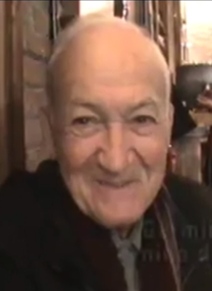
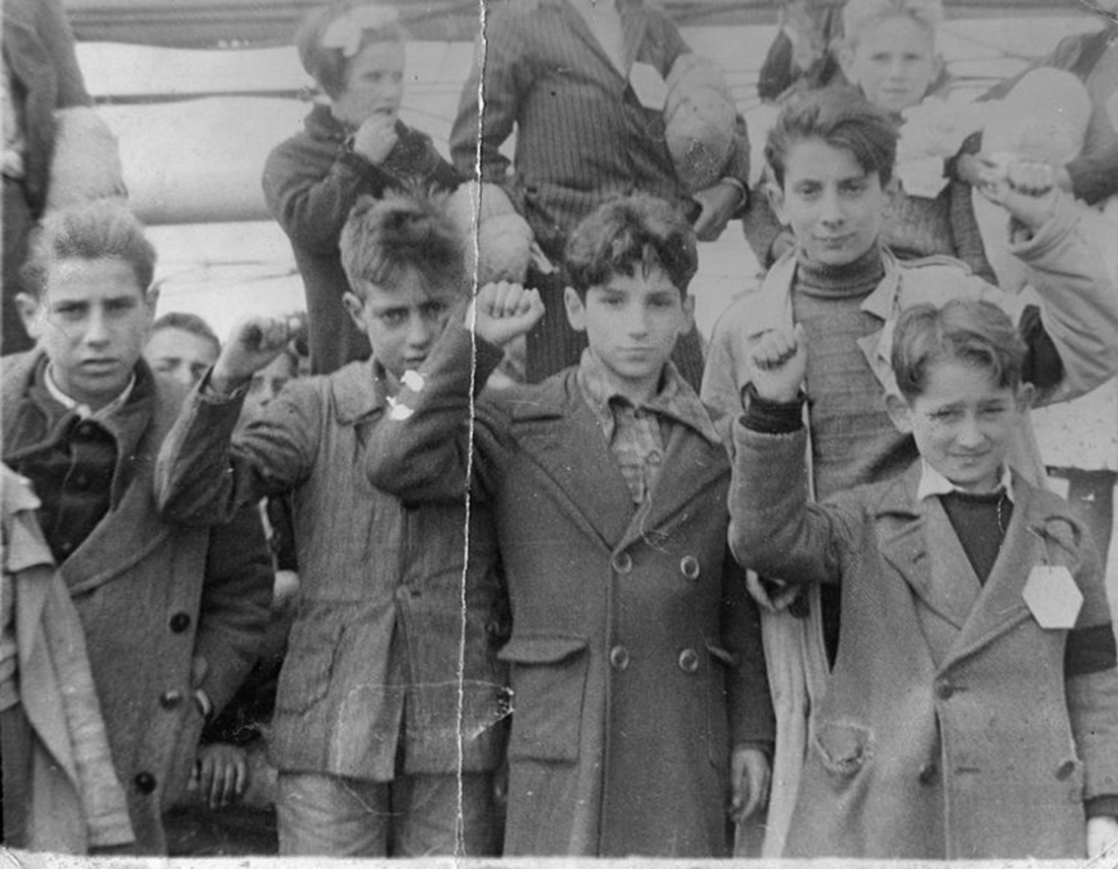
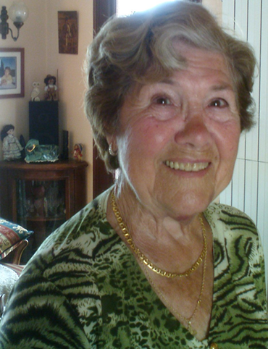

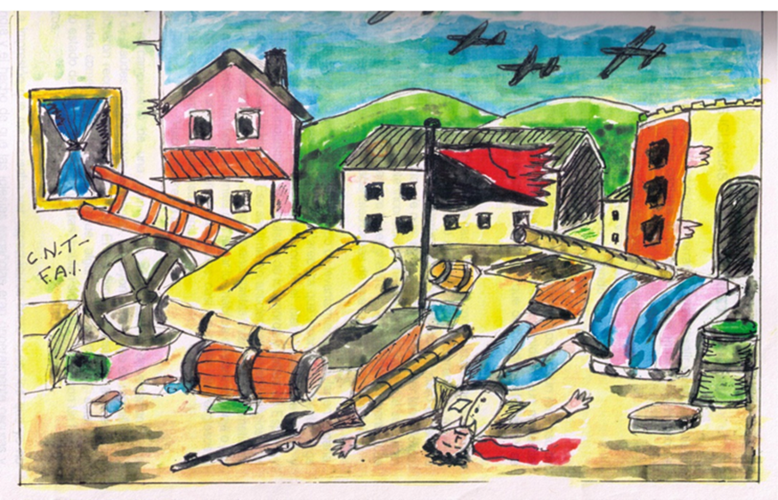
OpenLIVES research data
Wikimedia Commons Creative Commons Attribution-Share Alike 3.0 Unported
Notes:
The research data that will form the core of the project are 23 audio recordings documenting different forms of migration in 20th Century Spain. Each recording is accompanied by other ephemera such as images, drawings, transcripts, student translations.
Types of migration:
-child evacuations during the Spanish Civil War
-economic and political emigration during the dictatorship of the Franco regime.
-return migration to democratic Spain (When the dictator died in 1975 Spain begins a period of transition to democracy).
The project has a transnational scope: – we have stories that cross many borders at different times: Migration countries : Spain, France, the UK, former Soviet Union, Mexico, Cuba, Venezuela, Argentina and the USA
The interviews were collected as part of a previous research project - Tales of Return: the memories and experiences of Spanish returnee migrants from France and Great Britain (1959-1992) – funded by the University of Southampton in 2008-2009 under its Adventures in Research scheme. Researchers Alicia Pozo-Gutiérrez, Scot Soo and Darren Paffey. Once this project was finished, the material was shelved and forgotten, unavailable to anyone else – and was destined to remain so until the end of 2011, when we got funding to launch the OpenLIVES project.
The core of the material is recordings but it also includes, written memoirs, photographs, press articles, drawings and artefacts.
This range of material has direct applicability to language learning and content-integrated language learning, but it is also of interest to a wide range of disciplines including social science, politics, history, and economics. This raw data has been published openly in our repository called the Humbox, for others to download, adapt and use.

Slide 10
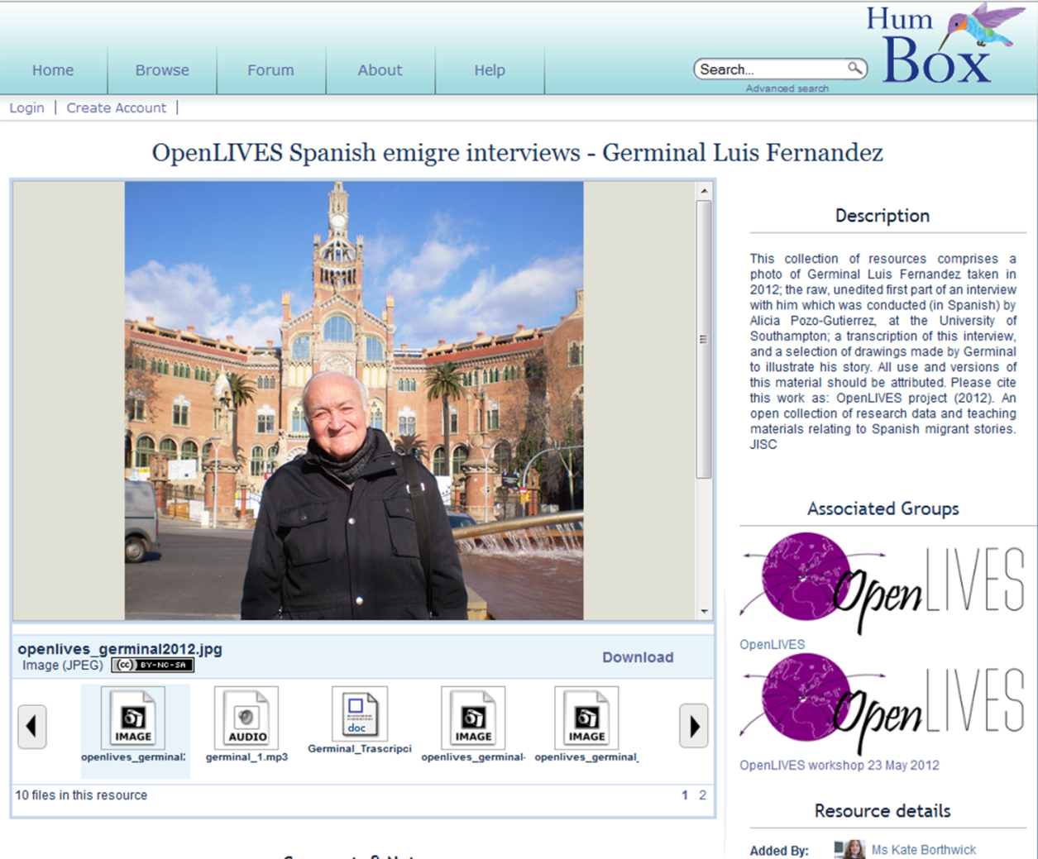
OpenLIVES: Southampton
Provided original research
“I was totally seduced by the concept” - original researcher
Dealt with permissions issues
Digitising materials
Notes:
The activities taking place at each institution are as follows:
Southampton provided the original research. The head researcher who collected the data originally, had few concerns about opening up her data to the world – as you can see from her quotation – she was totally seduced by the concept of her work being used by other students and spreading and expanding in ways she could never have predicted. However she did have some concerns about the integrity of the materials and worries about how the data may be used, or misused, after all these are personal testimonies – she felt it would be important to make sure that metadata and the context of presentation reflected “the spirit in which the materials were collected,” and the team have carefully considered how this material should be presented online and with which creative commons licenses and other descriptive information. She also noted that this particular group of interviewees had experienced extreme cultural oppression, and had a mistrust of officialdom – this meant that the issue of requesting additional permissions for open sharing was one which required great sensitivity. When the material had originally been collected, making it open access had not been envisaged – and this is something, that with increased openness, researchers will need to consider.
We have also been digitising and publishing materials.

Slide 11
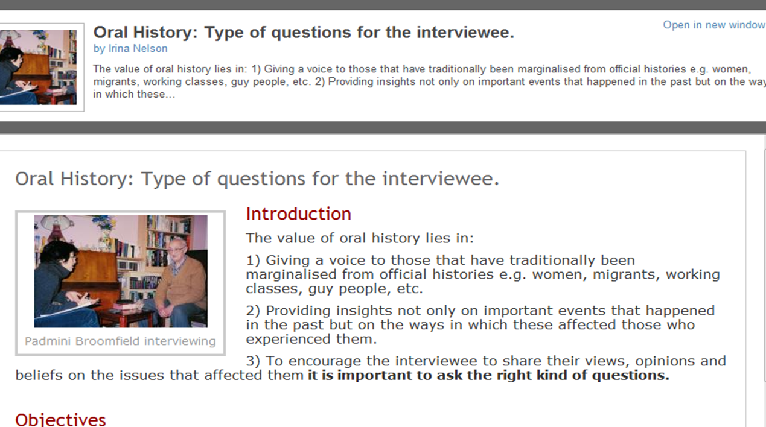
OpenLIVES: Southampton
Learning objects for research skills
Student translations, subtitling, file-checking
Notes:
From a resource point of view, tutors at Southampton are producing learning objects for research skills and have involved students in several aspects of the project: producing synopses in English for each recording, subtitling and checking audio files for clarity.

Slide 12
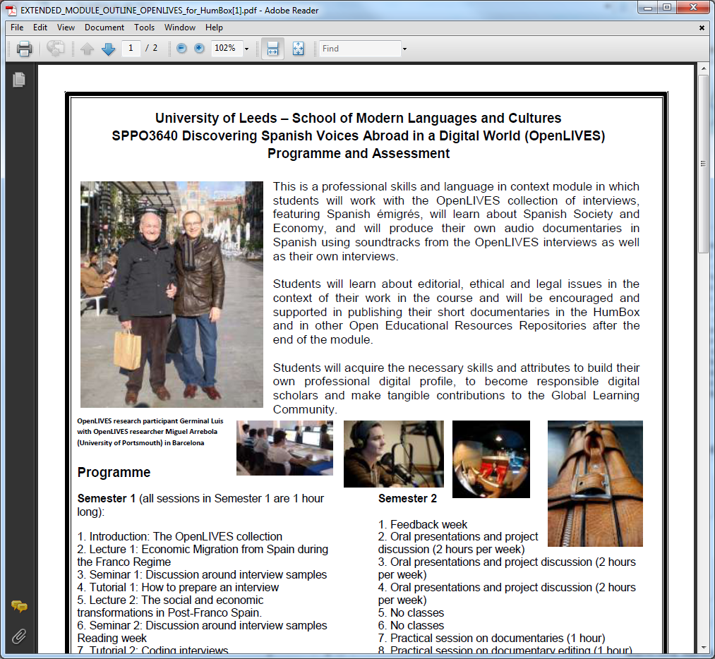
OpenLIVES: Leeds
Final year module running this year: ‘Discovering Spanish Voices Abroad in a digital world’
- interview and research skills
- technical skills (video/audio software)
- documentary production
Producing autonomous learning activities based on OpenLIVES data
Notes:
Leeds has created a new module for final year students ‘discovering Spanish voices abroad in a digital world’. This has run in the first semester of this last academic year and involves the preparation and production of a video documentary based on OpenLIVES materials. It entailed the learning of video production skills, research and interview skills and consideration of ethics and issues around open content and preparation of open content (as videos are intended to be OERs). The partner at Leeds has also produced autonomous learning activities based on OL data and has published all of his teaching content as he has delivered the module.

Slide 13
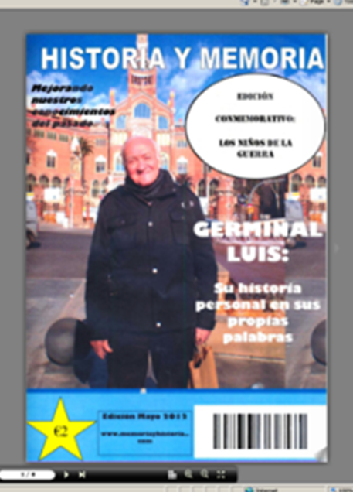
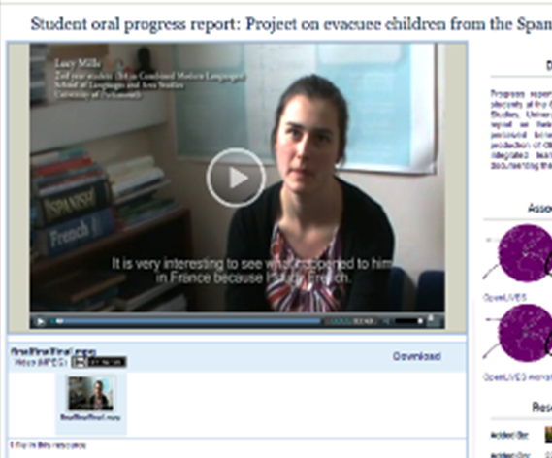
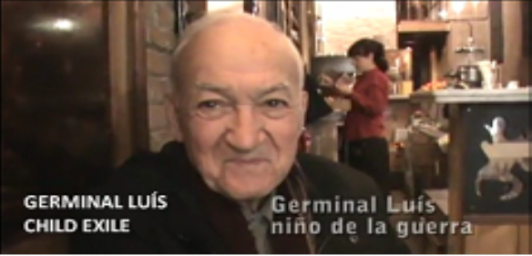
OpenLIVES: Portsmouth
Immediate integration of material: Languages for Professional Communication (2nd and final year module)
creation of interactive magazines
Student videos describing experiences
Video: Germinal Luis Fernandez
Notes:
creation of interactive magazines – using a magazine software, these magazines can be leafed through and feature a range of primary and secondary sources which students found and copyright cleared
Student videos describing experiences researching and creating magazines – these are available on HumBox
Miguel (our partner at Portsmouth), got his students to record questions to put to one of the OpenLIVES interviewees, Germinal Luis Fernandez, and then he went to Spain to put these questions to him and record the answers. [This video is on Humbox – and it was subtitled by students at Southampton in a fabulous inter-institutional collaboration].
In this semester, Miguel is using the student-created material with beginner students and final year students encouraging them to produce activities related to OL data.

Slide 14
OpenLIVES
Preserving and doing justice to research data
Producing student-centred teaching resources
Curriculum innovation and originality in teaching
Beyond education
Collegiality and trust
Join the OpenLIVES group and use the resources at: http://humbox.ac.uk/group/2
Notes:
So in summary, this project has achieved these things – through the medium of open working:
Preserving and doing justice to research data: A bank of testimonies has now been created which is making use of data which would otherwise be sitting unused (and unloved) on an office shelf. The people who gave their stories to the researchers were very keen that their experiences should be heard, so in sharing these testimonies as open content we feel we are doing justice to these stories and the people who lived them.
Producing student-centred teaching resources: In addition to being an archive these oral accounts are now being re-lived through the work that students and teachers are doing with the material in the classroom and beyond. Engaging students with the testimonies has involved classroom-based activities such as creating a magazine article using the data as well as actually helping to prepare the material for publication as OERs, which inlcudes writing summaries in English of the mainly Spanish language material. Indeed, in one case the students have actually had (indirect) contact with one of the people interviewed during the original research project. Students listened to his testimony then drafted questions to be put to him when their tutor met up with him in Barcelona, where he now lives. The resulting video was then subtitled in English by a different set of students to produce an entirely new OER (see http://humbox.ac.uk/3664/).
Curriculum innovation and originality in teaching: This project has also led to innovation in the curriculum with one partner creating a new module based around the material which as been approved and is now in progress. For the project partners, themselves, the sharing of teaching ideas and the opportunity to link research and teaching has been particularly powerful. Talking to each other about the testimonies and how to incorporate them into the classroom has given a whole new lease of life to the research and has inspired some really excellent teaching ideas. Clearly OER does not lead, some might fear, to sameness or lack of originality in teaching as the ways in which the research data is being used and the personal stamp each partner is putting on the material shows how flexible and heterogeneous these OERs can be. They are very much living objects which can be mixed, matched, adapted, expanded, remixed and updated in a wide range of ways, each of which is unique and different.
Beyond education: Out there in the wider world there is the potential for ongoing interaction with a broad audience who might also be interested in, inspired by and active in using the raw data and the OERs created from it. Putting these very personal stories out into the world is reaching out to a range of audiences who, it is hoped will, in their turn tell new stories through their engagement with and use of the material.
Collegiality and trust: In the highly competitive world of higher education this project has clearly shown that when colleagues work together across universities as a community of practice collegiality rather than competition prevails. Rather than giving away their institution’s Crown Jewels participants in this project are showing how their work can contribute more jewels to the crown through their creative use of the source material and indeed of the ideas (OERs) of others.
This is a project which is bringing open practice and the digital world into the heart of teaching and research and showing how this can be a really good thing.
So I hope you can see that through all of our projects, we have seen an evolution in engagement from language educators with OERs, and also an evolution in understanding about how beneficial open practice can be.

Slide 15
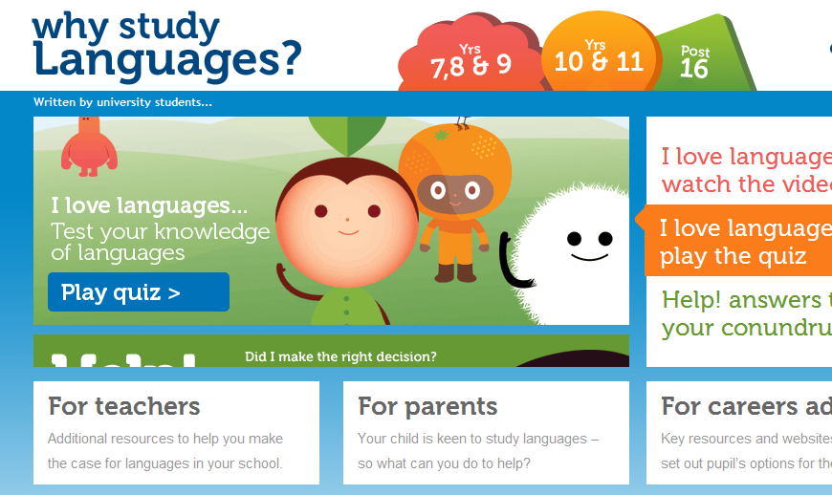
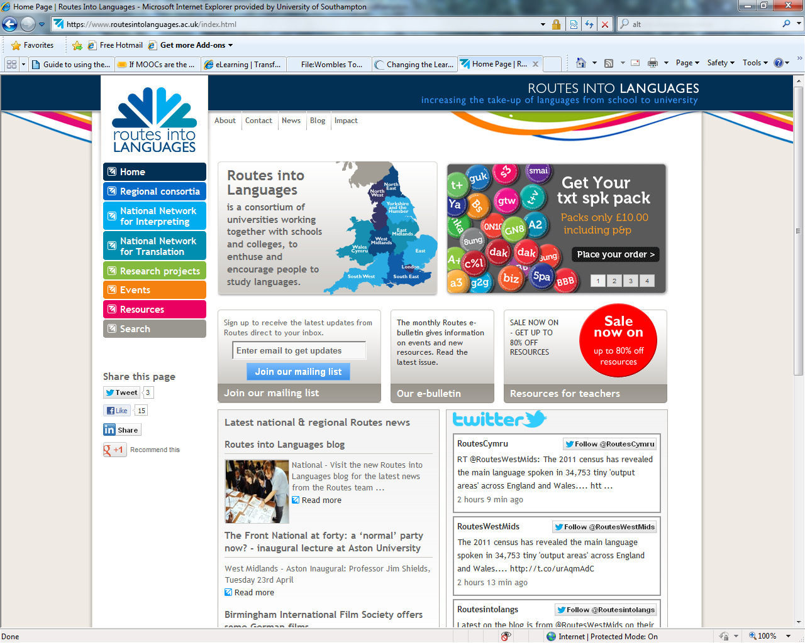
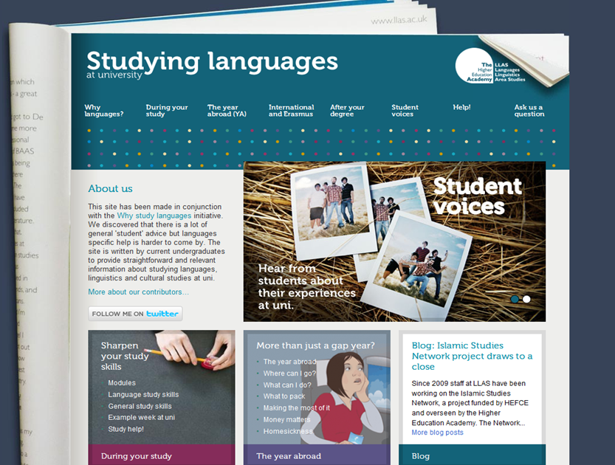
Notes:
The LLAS Centre is one of several support services available to language teachers. I’m going to mention a few, but please share any others that you know through the chat window.
LLAS runs several websites – in addition to the HumBox and the LanguageBox – which provides resources and other support for language teachers. Routes into Languages is a UK government funded project which seeks to increase the up-take of languages from school to university and ‘why study languages’ is a website of resources for school pupils, teachers and parents, which aims to interest students in language learning.
This is complemented by a website called ‘studying languages’ at university, which was largely written by student interns which provides support and information for prospective and current university languages students.
LLAS also holds two big elearning events each year: a symposium for HE teachers and a conference for teachers.

Slide 16
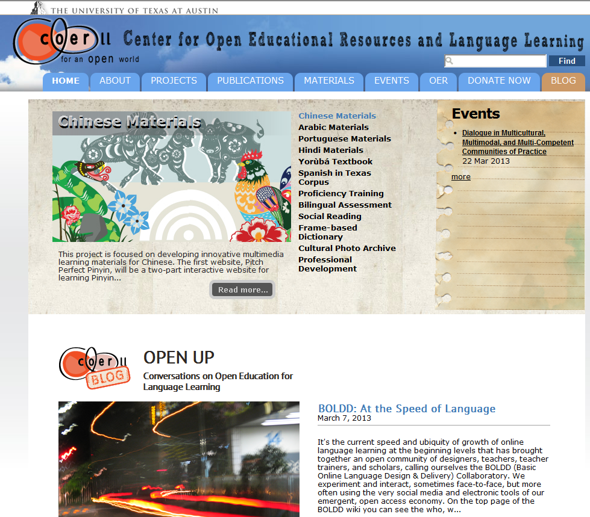
COERLL
Centre for Open Educational Resources and Language Learning
Based at University of Texas at Austin
Funded by US Dept of Education
One of 15 national language resource centers including LARC
Aim: to improve teaching and learning of MFL
http://coerll.utexas.edu/coerll/home
Notes:
Another excellent support service is COERLL. COERLL’s mission is to produce and disseminate OERs, rather than simply online resources, although all of the 15 centers produces resources. Some of the centers focus on particular languages, e.g. Asian languages or Slavonic and East European languages. A full list can be found at the COERLL website. This includes LARC, based at San Diego.
A slide at the end of this presentation will include useful general links to OER sites, with information about how to get started and some of the benefits and challenges of OER.

Slide 17
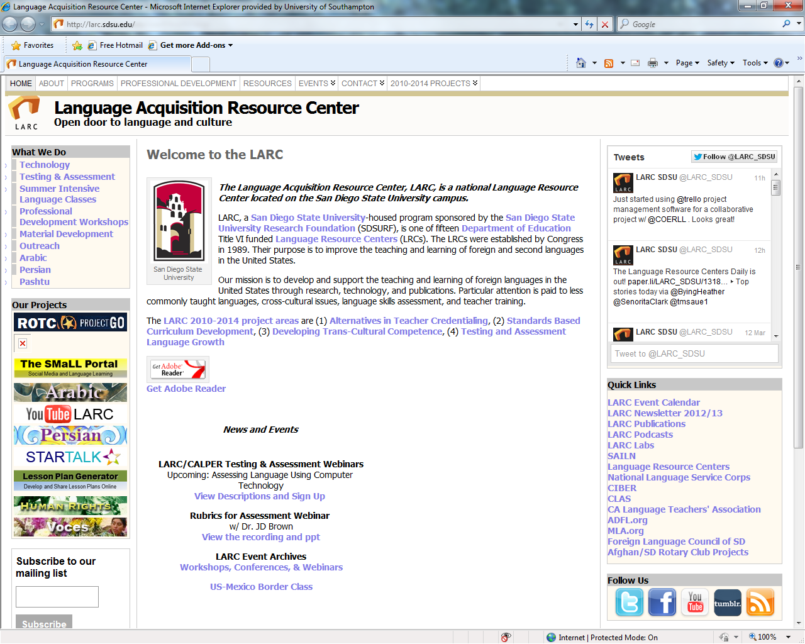
LARC
Language Acquisition Resource Center
Based at San Diego State University
One of the 15 government-funded language resource centers
Notes:
LARC is another example of one of the 15 Language Resource Centers funded by the US government. It is based at San Diego State University and offers a range of resources. I’ve included a link at the end of this presentation, to a map which shows all of the centers and can direct you to each of their websites.

Slide 18
Communities
Follow OER language teacher communities on Twitter and Facebook
MFL Twitterers “the best staffroom in the world” #mfltwitterati
Times Educational Supplement - @tesMFL and MFL forum http://community.tes.co.uk/forums/28.aspx and community teaching resources http://www.tes.co.uk/teaching-resources/
The Guardian website (newspaper): resources http://www.guardian.co.uk/education/languageresources
Notes:
Resources for language learning can be found in all the places we have talked about: LORO, LanguageBox, HumBox, OpenLearn, Jorum, Xpert, also iTunesU, institutional open repositories and other sites – there are so many places to find useful resources and information. One way to keep track of all of this is to join a community site and subscribe to their Twitter or Facebook feeds.
Both LLAS and COERLL have twitter feeds.
MFL Twitterers is a list on Twitter that you can subscribe to. Follow list members to find out more about useful tools and resources. It is a very active largely UK-based community of language teachers. Post or search under the tag #mfltwitterati.
TES – The Times Educational Supplement, a magazine in the UK, regularly tweets about MFL topics and hosts a popular MFL forum, to which you can post questions. It also hosts a community site devoted to the sharing of teaching resources – you can join this and contribute your own work.
A UK newspaper called The Guardian also provides resources too.
The schools community is very active in the UK – please share any other networks that you use and join other communities to share ideas – there are so many places to find OERs now…

Slide 19
Useful links for info and advice (OERs)
OER Infokit: http://bit.ly/oerinfokit
Legal advice and rights information: http://www.web2rights.org.uk/index.html
Open Courseware Consortium: www.ocwconsortium.org
Support services:
LLAS Centre www.llas.ac.uk;
For schools: www.routesintolanguages.ac.uk and www.whystudylanguages.ac.uk
For HE: http://www.studyinglanguages.ac.uk/
COERLL: http://coerll.utexas.edu/coerll/home
Map of US language resources centers (including links to all sites): http://coerll.utexas.edu/coerll/lrcs/lrc-map

