Slide 1
Plagiarism & Referencing
1. Understand what plagiarism is, and how to avoid it
2. Know how to reference your materials
3. Develop your own authorial voice
Richard Galletly MBA PGCPP FHEA

Slide 2
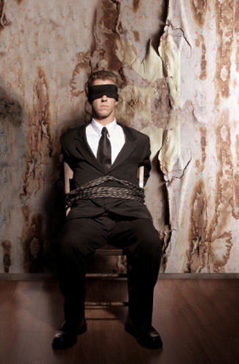
Kidnapper–Plagiarius–Literary theft
They have kidnapped my words! – Martial, 103 AD

Slide 3
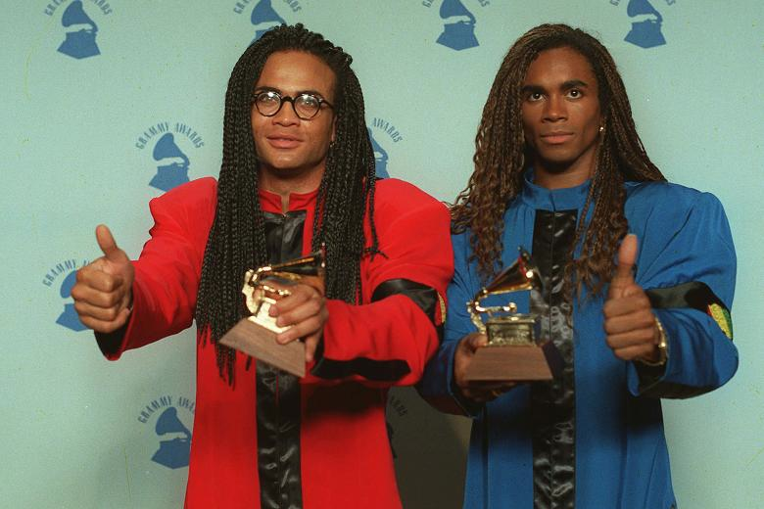
Plagiarism–a strategy for success?
ROB
FAB
Milli Vanilli – Grammy winners, ‘best new artists’ 1990
http://youtu.be/cG6fRHzVpNU

Slide 4

Know your enemy
‘Guaranteed’ Undergraduate 1st: £460. Tempted?
http://www.writemyessay.co.uk/

Slide 5

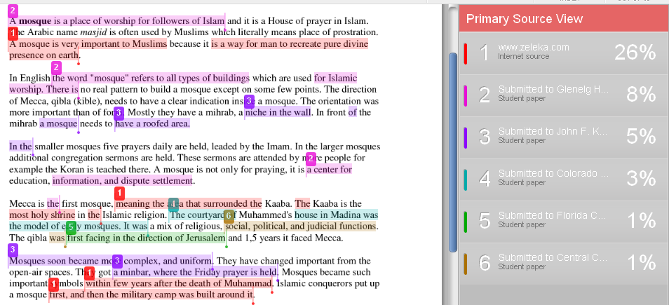
Plagiarism detection:

Slide 6
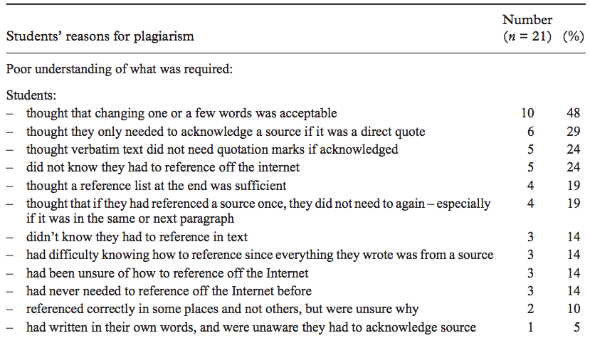
Students’ reasons for plagiarism
Ellery, 2008

Slide 7
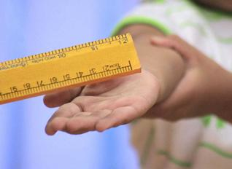
Fair punishment? or imposed values?
- In 2006, an Australian lecturer charged his entire class with academic misconduct for plagiarism (East, 2009)
- 60 students at Harvard suspended in unprecedented cheating scandal, February 2013
^{Justice,}
^{rights}
^{and rules}
^{Responsibility,}
^{relationship}
^{and care}
Cultural differences: perceptions of what is fair & acceptable?

Slide 8
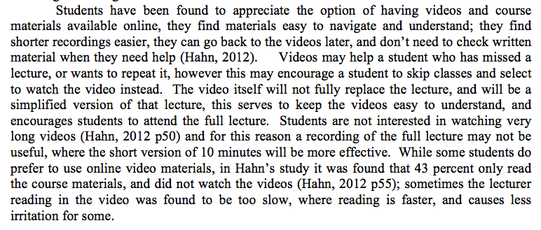
Citations in text
Read the source; comment, reflect, assess, critically evaluate, discuss - & then cite!

Slide 9
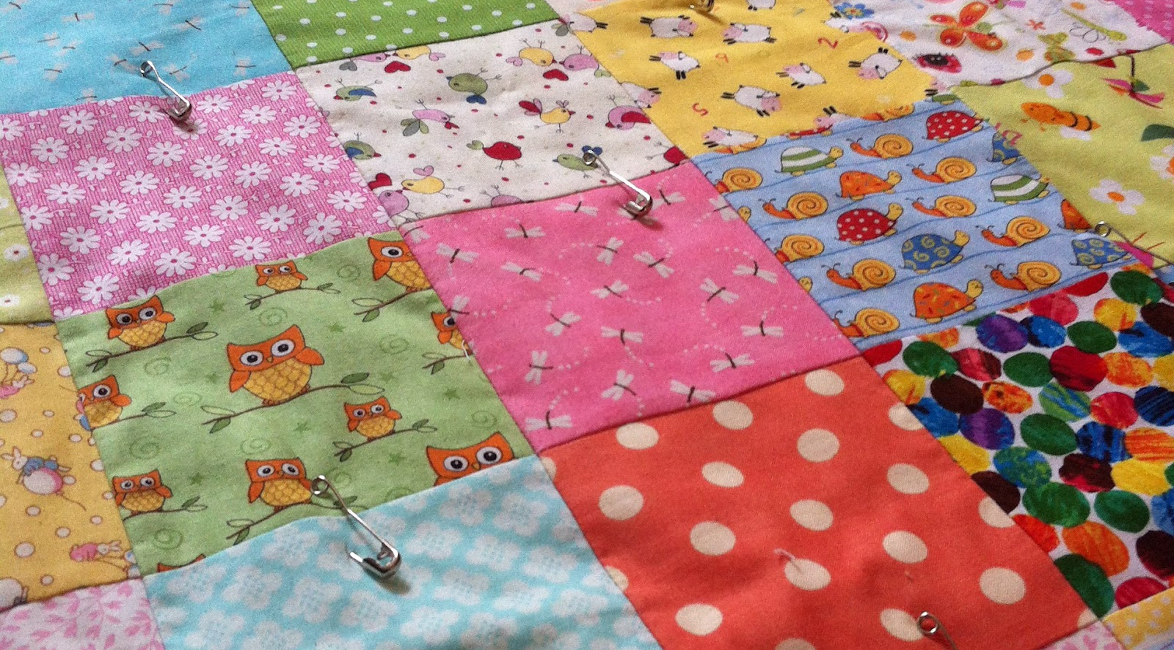
Patchwork essay: ‘patchwriting’
Knowledge telling / knowledge transformation?
Part of a process of writing in a second language?

Slide 10
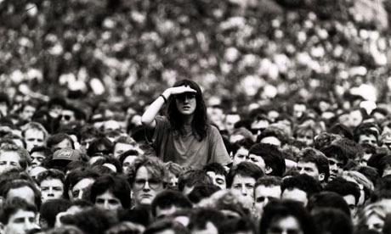
Your own voice in the essay
Trying to stand out in a crowd of other people’s ideas?

Slide 11
Though students may be considered experts in the use of new technologies, including emerging learning technology such as Youtube, it is not known how best to implement this learning tool for optimal student learning.
Not only does the design of these videos need to take into account the differing backgrounds of the students, the capacity of these students to recall the information presented, and to use this effectively to complete tasks should also be considered. This is known as the ‘cognitive load’, where a lecture may cover a great deal of insights, information and detailed content, it has been argued that the video should be shorter and more casual in its design (Seery & Donnelly, 2011 p670).
My voice
My voice
Voice of S & D

Slide 12
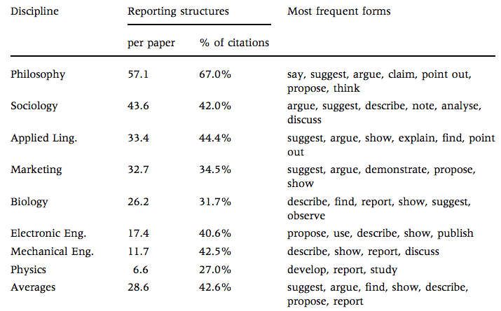
Reporting on other sources
Ken Hyland, 1999 - Reporting verbs used in citations

Slide 13

A conflicting maze of ideas
Guide your reader through the concepts using rhetorical strategies (discussion/ argument/ evaluation/ criticism)

Slide 14
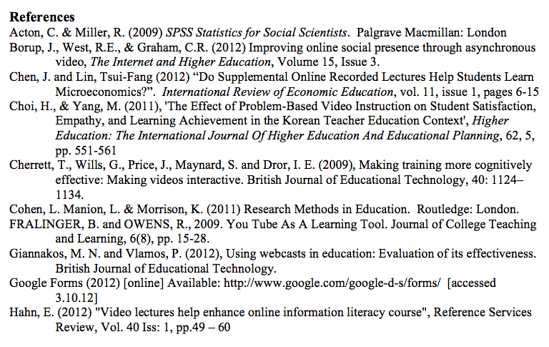
List of references

Slide 15

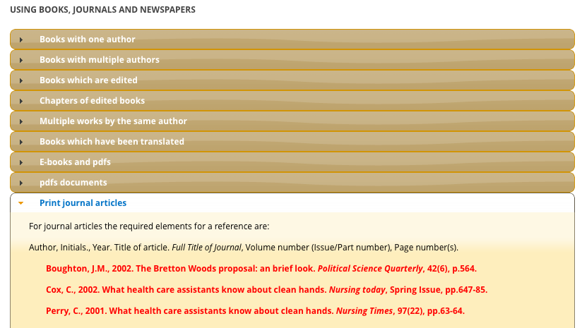
Harvard Referencing Guide
http://libweb.anglia.ac.uk/referencing/harvard.htm

Slide 16
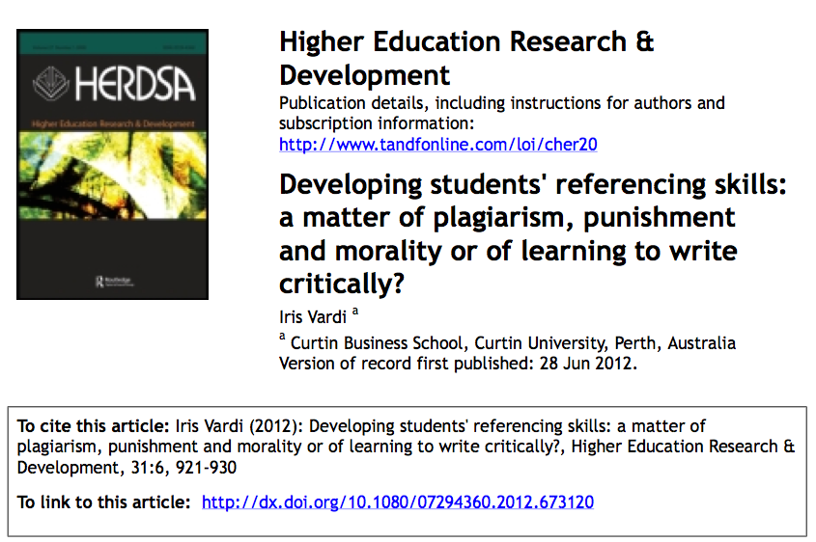
Referencing an article

Slide 17

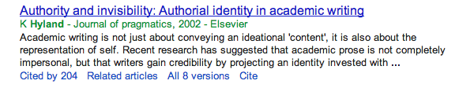
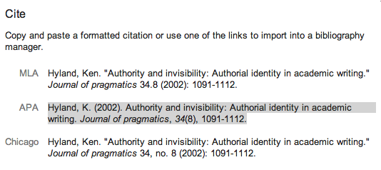
Finding citations using
http://scholar.google.co.uk/

Slide 18
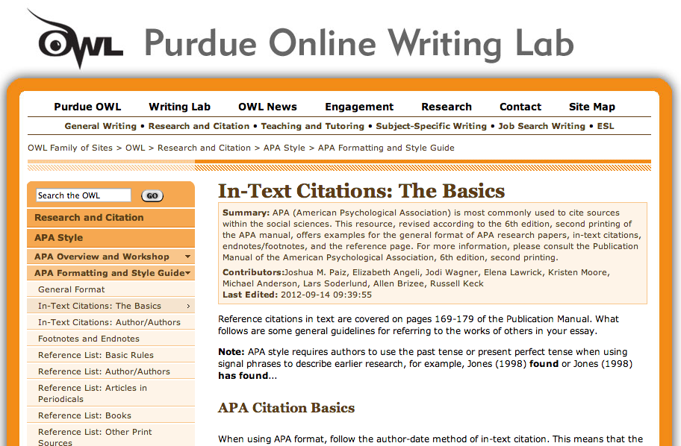
According to Jones (1998), APA style is a difficult citation format for first-time learners.
http://owl.english.purdue.edu/owl/resource/560/02/
Notes:
http://web.ebscohost.com/
search.proquest.com
http://www.jstor.org/
http://libweb.anglia.ac.uk/referencing/harvard.htm
http://owl.english.purdue.edu/owl/resource/560/02/
Using google scholar for citations

Slide 19

Should major companies take Fair Trade seriously?
Read > Summarise > Discuss, Reflect, Critically Evaluate > Write (& Cite!)
a wide possibility of different answers will prevent plagiarism;
Include your experiences, research your own examples and cases

