Slide 1

Finding a Voice through Open Resources: FAVOR
Alison Dickens
Centre for Languages, Linguistics and Area Studies
University of Southampton
AULC Meeting 10th January 2013
LLAS
Centre for Languages, Linguistics and Area Studies
University of Southampton
Southampton, SO17 1BJ
+44 (0) 23 8059 6860 | @LLASCentre | www.llas.ac.uk

Slide 2

Overview
What is FAVOR?
Why this project?
Why open practice?
What was achieved?
How can you use FAVOR in your institution?

Slide 3
The FAVOR project
Finding A Voice through Open Resources (JISC)
Part-time, hourly-paid language tutors
Sharing existing resources as OERs
Creating new transition resources for prospective university applicants: ‘taste of’ new languages; language study at HE
Collaboration: Southampton, SOAS, UCL SSEES, Aston, Newcastle
Notes:
So what is the FAVOR project? Well, briefly…
The FAVOR project is funded by JISC, under their open educational resource (OER) programme, and ended in October 2012. It stands for ‘finding a voice through open resources’ - it worked with part-time, hourly-paid tutors to do two things: the first phase was to get tutors to publish and share their existing teaching resources as open content to build up a public, professional profile and to share their expertise with the world. When I say open resources, I mean teaching or learning resources that have been published online and licensed so that other people can download, adapt them and use them for their own purposes.
The second phase was for the tutors to create ‘transition’ materials for prospective university students – these would be new OERs designed to assist potential students in understanding how languages are taught in HE, and to give a taste of some of the new languages that can be studied at HE level but not in school. Collaboration between tutors at Southampton, SOAS, UCL SSEES, Aston and Newcastle.

Slide 4
Issues for hourly-paid tutors
Often unrecognised and undervalued
Employed in ‘Language Centres’ separate from academic depts
Teaching-only contracts
“…could be forgiven for feeling like second-class citizens,” Klapper, J. (2006)
Intensive teaching schedules
Lack of opportunity to engage with academic life and professional development opportunities
Notes:
At LLAS, we have been working with language educators for 11 years and so we are very aware of the issues faced by hourly-paid language tutors and the reasons why it is difficult to engage such tutors in projects and opportunities that permanent, full-time staff have access to.
in summary:
Such tutors are often unrecognised and undervalued for the work that they do –despite often delivering significant amounts of the language programme in an institution
Often employed in language centres, focussing on language and separate from academic departments which may focus on content – culture, history, politics and so on.
They are often on teaching-only contracts, paid for contact hours alone and are called ‘teaching fellows’ or language tutors – i.e. not doing research, not academic and therefore, of lower professional status than a researcher.
They also tend to have intensive teaching schedules, leaving little time to engage with projects or research, and often have little opportunity to engage with academic life in their institution or prof dev opps – can feel quite isolated and not part of the institution they work for
Have little opportunity to contribute to their institutions’ strategic aims beyond delivering teaching
When we saw JISC’s call for bids, we saw an opportunity to address many of these issues. We felt that this group could benefit from some of the opportunities afforded by open practice – particularly in the area of professional development perhaps hard to come by through more traditional routes– and this is what we are exploring through the project this year. We had previously run a project in a similar vein with Community Languages teachers (the Community Café Project) and had found that the opportunity to network, share and develop new skills was particularly lacking for and appreciated by this group.

Slide 5

What is OER?
Notes:
open
free
online
licensed
shared
teaching
technology
course
learning
research
assets
remix
repurpose
adapt
public
resources
adapt

Slide 6
OER?
“Open Educational Resources are teaching, learning or research materials that are in the public domain or released with an intellectual property license that allows for free use, adaptation, and distribution.”
Unesco
http://www.unesco.org/new/en/communication-and-information/access-to-knowledge/open-educational-resources/
Notes:
An OpenCourseWare is a free and open digital publication of high quality educational materials, organised as courses.
In 2001, MIT was the first university to work on putting many of the teacher-defined support materials from its undergraduate and graduate courses online, in MIT OpenCourseWare

Slide 7
Open Education Resources (OER)
  “OERs are learning materials that can be accessed, used, and transformed by anyone, anywhere.”
  Guardian 4th July 2012 http://www.guardian.co.uk/higher-education-network/blog/2012/jul/04/open-educational-resources-and-economic-growth
  “Open educational resources are digital materials that can be used, re-used and repurposed for teaching, learning, research and more, made freely available online through open licenses such as Creative Commons. OER include a varied range of digital assets from course materials, content modules, collections, and journals to digital images, music and video clips.”
  Higher Education Academy
  http://www.heacademy.ac.uk/oer
Notes:
Guardian 4th July 2012 http://www.guardian.co.uk/higher-education-network/blog/2012/jul/04/open-educational-resources-and-economic-growth

Slide 8
OER?
“The term ‘open educational resources’ was coined by United Nations Educational, Scientific and Cultural Organisation (UNESCO) in 2002 (Caswell et al., 2008) and it embraces OpenCourseWare but would also include any educational materials, technologies and resources offered freely and openly for anyone to use and under some licences to remix, improve and redistribute.”
OU OpenLearn. Creating Open Education Resources
http://www.open.edu/openlearn/education/creating-open-educational-resources/content-section-2
Notes:
An OpenCourseWare is a free and open digital publication of high quality educational materials, organised as courses.
In 2001, MIT was the first university to work on putting many of the teacher-defined support materials from its undergraduate and graduate courses online, in MIT OpenCourseWare

Slide 9
Benefits of open practice
Can demonstrate impact to institution as well as beyond
Colleagues who work cross-sector, cross-institution can bring work together under one online profile
Facilitates networking locally and beyond
Creating new, high quality OERs will raise profiles of creators
Increases the pool of relevant, adaptable resources available (especially for less widely taught languages)
Enhances digital literacy and professional practice
Notes:
Through the project, we sought to try and address some of those issues of low status and isolation, and raise the profile of language tutors who are in this position. Open practice is a low-cost and easy way to do this. Some of the things we discovered from working with our tutors:
Engaging with open practice:
Demonstrates impact but also contribution to an institution – we don’t yet know what impact this will have, but we will evaluate this. It is becoming increasingly important for depts to demonstrate impact in a range of ways – from all staff members – OER offers a forum for marginalised staff to contribute to. Publishing work openly raises personal profiles and can put staff on the map.
Tutors who work across several institutions or sectors can have a coherent work profile which brings everything in their professional life together; the profile can also more strongly link them to a particular institution. Also employment opportunities – another way of selling yourself and raising profile – and connecting you to an institution or organisation.
Facilitates networking – this has resonance as in some cases, language tutors are the only tutors of their particular language in an institution – they can start to communicate, collaborate and share ideas with other colleagues; and in fact, working on the project has allowed tutors to network with each other and generated a sense of belonging to their institution because they know their work will contribute to the institution’s strategic aims – attracting new students.
Creating new open resources which will be shared through institutional sites as well as our repository will raise the profiles of the authors and flag up their work. The act of creating open content, and considering formats, content, licensing improves professional practice and enhances digital literacy
Increases pool of quality, relevant, up-to-date resources available for others to adapt and use
Enhancing digital literacy – engaging with issues around OER and participating in training workshops and attending conferences to talk about their open practice/sharing ideas with project colleagues.
Engagement with all of these aspects, we hope, will enhance the status and prof dev of tutors involved in the project – and offer some really useful and interesting resources for the community to use and adapt. We hope that the tutors’ relationship with open practice will continue to flourish beyond the project.

Slide 10
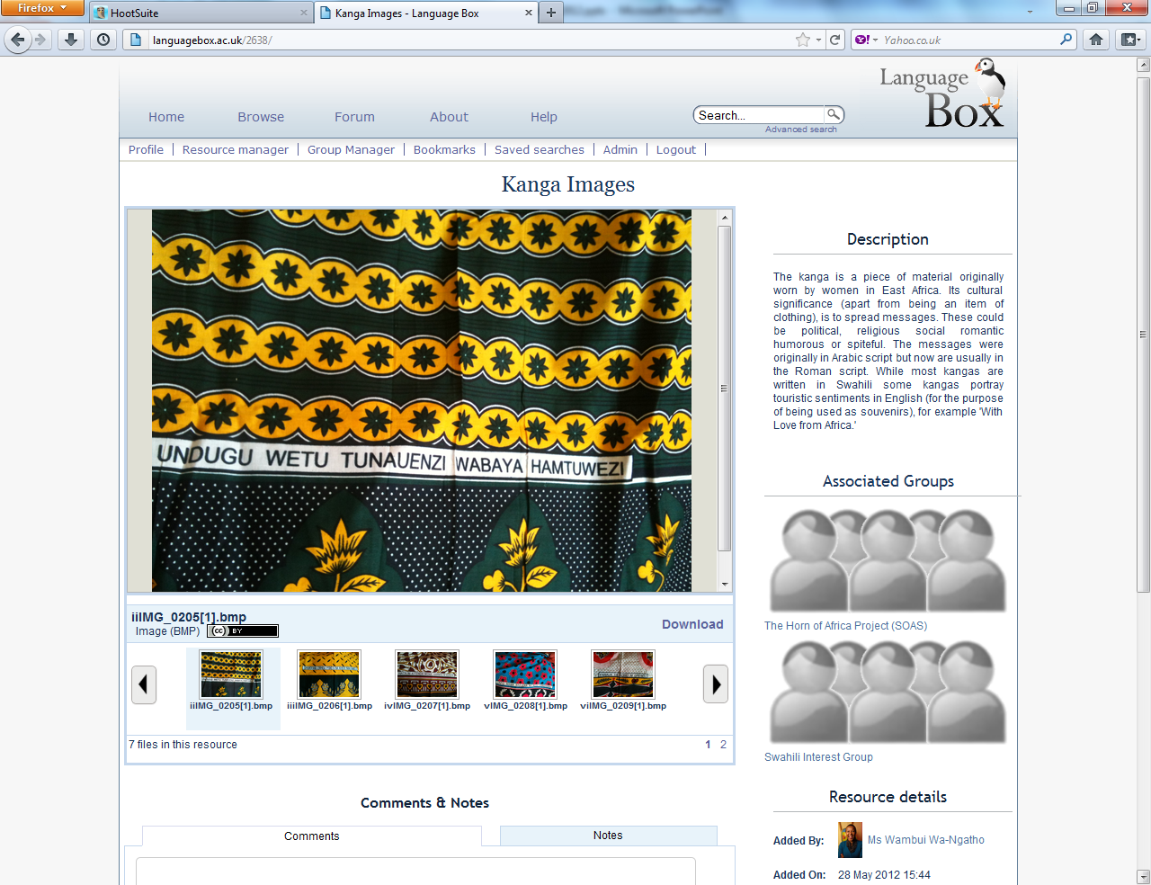
Notes:
Range of languages: Finnish, Hungarian, Latvian, Serbian, Slovak, Estonian, Ukrainian, French, German, Italian, Chinese, Arabic, English as a Foreign Language, Persian, Spanish, Japanese, Swahili, Amharic, Somali and Tigrinya. These resources range from images – such as these striking kanga images used in teaching Swahili – to handouts describing effective classroom activities, powerpoint files teaching key points of Ukrainian, Chinese or Japanese, conversation questions for Finnish, interactive activities, creative writing for Spanish…
Over 300 resources have been uploaded during the course of the project, some of which were newly created by the tutors involved as language tasters e.g. Finnish words, taste of Ukrainian

Slide 11
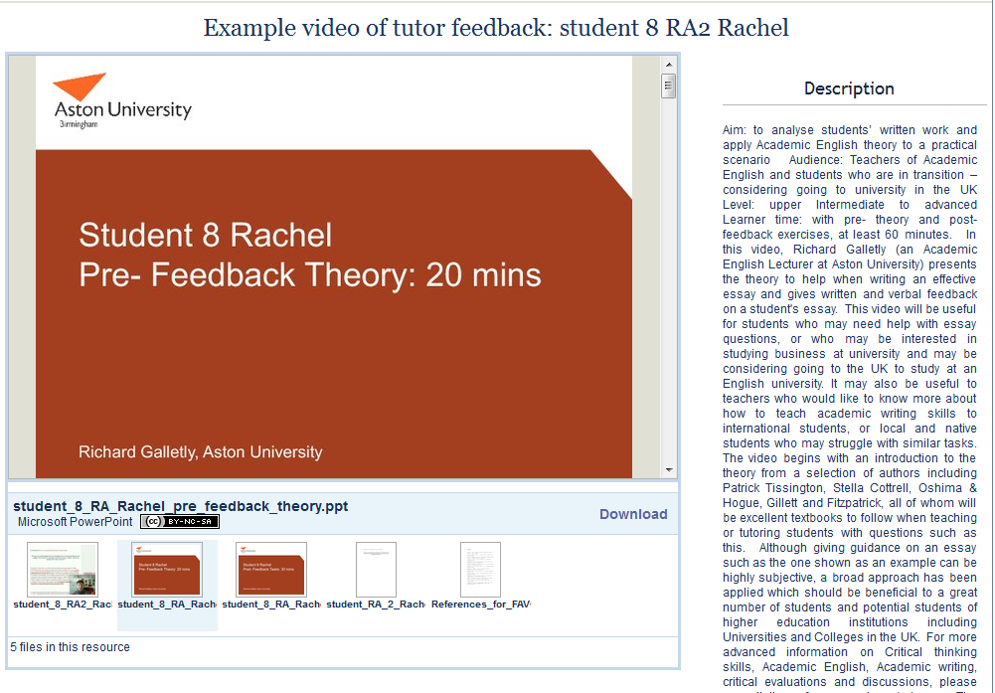
Notes:
This is an example from Aston university – one English language tutor has shared a large number of examples of how he gives screencapture feedback to his academic writing students – this file includes a screencapture file (an interactive video of him talking through a feedback example) and some powerpoint files and other guidelines for tutors.
The website we are using for the project is called The LanguageBox and it is managed by LLAS – but anyone can join.

Slide 12
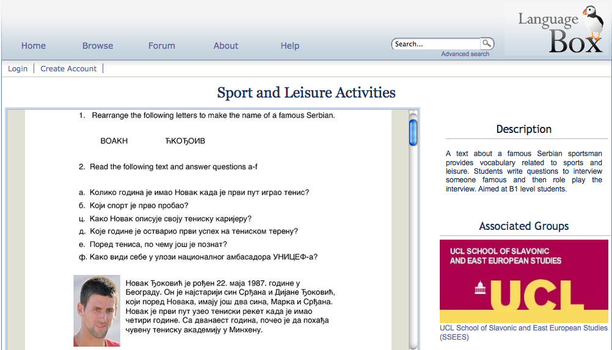
Notes:
Serbian worksheet

Slide 13
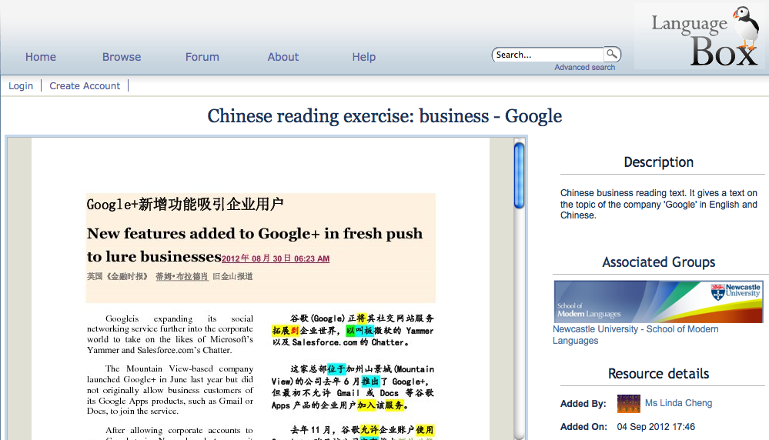
Notes:
Chinese worksheet for business

Slide 14
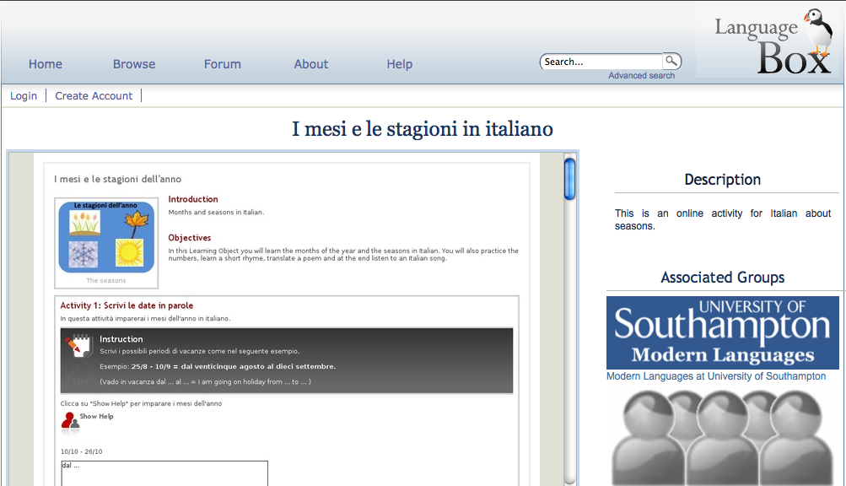
Notes:
Italian Learning object created using Learning Object Creator (LOC)

Slide 15
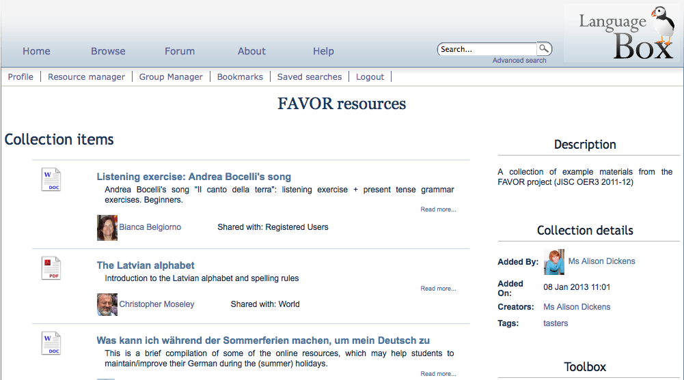
More examples

Slide 16
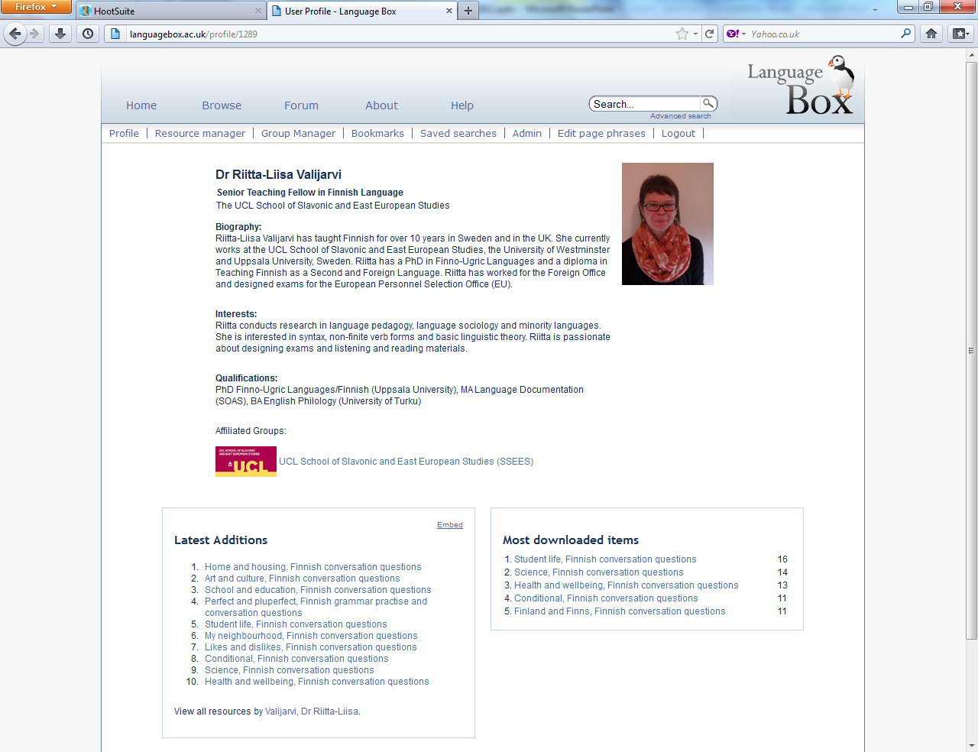
Notes:
When you join, you set up a profile in which you can describe your professional interests. This is one of our tutors – who is at this conference, so say hello! DESCRIBE – you can see here – this little icon – indicates that Riitta is part of a group (in this case UCL tutors) and if I click on that link I can see the group members.

Slide 17
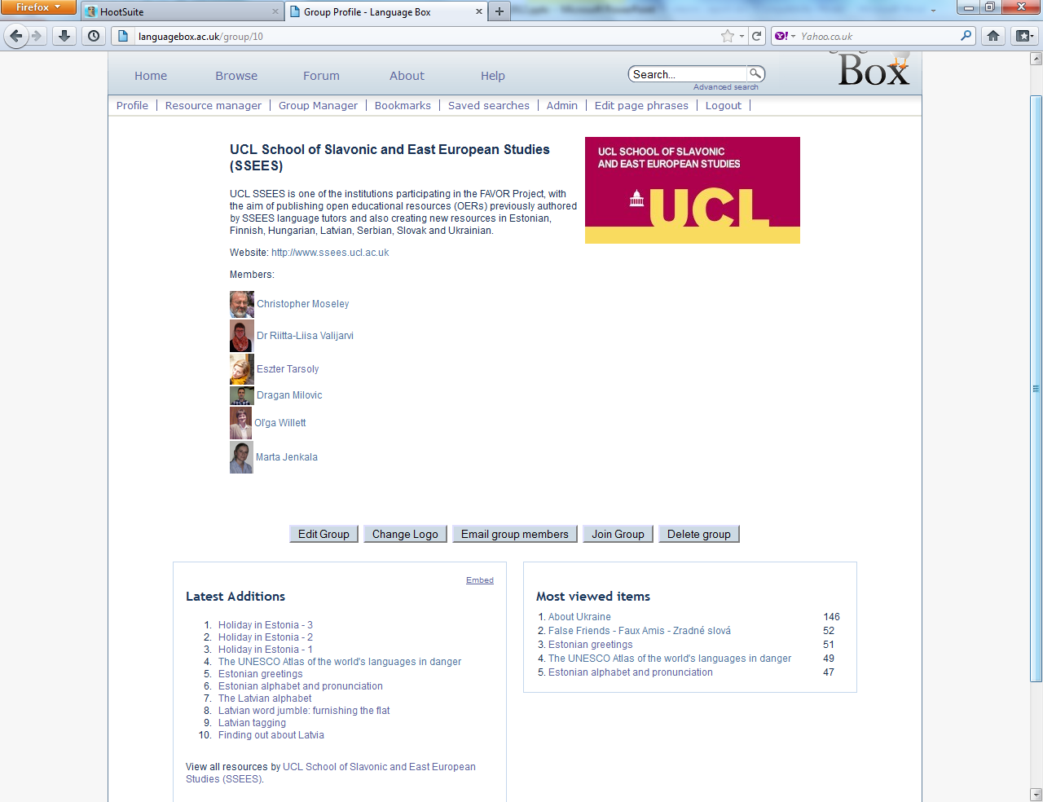
Notes:
Here we are – there is the UCL logo, and I can see the members of the group – if I clicked on their names, I could see their profile pages. I can see which resources have been uploaded as part of this group…and if I wanted to, I could click ‘join group’ and I could join it!
The LanguageBox is an open site, which anyone can join and start sharing their work through. Anyone is free to set up groups too – and some of the tutors are intending to set up their own interest groups around the languages that they teach. Wambui has done this for Swahili – so if you teach or learn Swahili, you may wish to join that group!
So.. Phase 1 – which is about sharing existing resources has moved into phase 2 – creating new resources.

Slide 18
Impact on tutors
New skills acquired
Improved practice
New opportunities taken up
Enhanced feelings of belonging and contribution to their institution
Enhanced feelings of community
Enhanced confidence and pride in their work
Change of practice
Change of attitude towards open practice
Notes:
Tutors have enjoyed the process of sharing – and meeting colleagues involved in the project to share ideas and practice. This rarely happens in most institutions. There is a positive feeling to being part of a collective endeavour. We hope to find out more about how engaging with open practice has impacted on tutors’ practice by the end of the project.
Issues of copyright, quality etc have not been as troubling as many assumed they may be – many tutors were worried about IPR, quality – was their work good enough? But actually, we have a rights officer checking materials and there are not so many issues as were expected – and concerns about quality proved to be groundless – we emphasise that LanguageBox is a site for practitioners and so of course, the materials tutors prepare for their students are absolutely right to be shared.
Issues of engagement with such a project are staggering and this area needs more work before tutors can properly engage with small projects/anything outside their teaching. This means that engagement with research and small projects needs to be part of how employers construct the work contracts of tutors – otherwise they fill their time with teaching. Hourly-paid tutors often feel they must take on a large amount of teaching in order to ensure that they have work, but then if student numbers come through, they have to deliver all that teaching! Similarly, tutors may often be pulled away to do other jobs, in other institutions – and so any time to be spent on small projects needs to be ring-fenced somehow.

Slide 19
Comments: new skills
“I enjoyed taking pictures of students [for my materials]…and uploading them. I didn’t know how to do that, but I learnt. I then tried to send the powerpoint to the students but it was too big…the files were too big. So…I asked them to go to the LanguageBox and they could find it, and they were very happy.” – comment made at meeting, 20th September, 2012

Slide 20
Comments: improved practice
“I will be using resources with students. It has opened my horizons and now I can see how I can improve (in technology). I’m so motivated. I want to go to workshops and use powerpoint – get new skills. I didn’t know I’d enjoy preparing materials so much.” (focus group)

Slide 21
Comments: new opportunities
“For some this was the first opportunity to engage in conferences, talking about their experiences on the FAVOR project – not just attend conferences but present at them. And some of them have voiced to me that they would like to continue to find opportunities to do this, as a form of professional development.” – Southampton final report.

Slide 22
Comments: community
“It helped that we had a Newcastle Group in LanguageBox as well, because it gave everyone a sense of pride and identity” – Newcastle video
“It has made me feel part of the university” – Southampton final report
“... it was great to be able to compare your resources with those of your colleagues” – UCL final report

Slide 23
Comments: confidence
“It was rewarding…seeing tutors bloom [through working on the project].” – project coordinator, focus group
“I got encouragement from the team to believe in my resources.” (focus group)
“We’ll encourage colleagues to publish once the project has ended. Initially it was difficult to know what to put into LanguageBox, but it has come into its own through our use of it…I’m sure I would be jealous of us if I looked at what we’d done now.” (focus group)

Slide 24
Comments: practice change
“the project has started me thinking about teaching in a new, visually oriented way.”
“Tutors have constituted themselves as a small community of practice as they now meet more regularly for professional inquiry and discussion and they have committed themselves to meeting regularly beyond the life-time of the project” – SOAS final report
Notes:
.

Slide 25
Comments: attitudes to OER
“I am so happy to upload and let everybody else to see them [resources]. I don’t have reservations, they can go and have a look and do whatever they want with them.”- focus group
“You asked me about what I liked about the project and for me it was sharing. You spend so much time doing this [creating resources]…the more people who can use it, the better.” – comment at meeting, 20th September, 2012
“Engaging with open practice made me realise that there is a lot to be learned online.” – comment at meeting, 20th September, 2012
Notes:
.

Slide 26

The tutors’ experience
Notes:
Tutors have enjoyed the process of sharing – and meeting colleagues involved in the project to share ideas and practice. This rarely happens in most institutions. There is a positive feeling to being part of a collective endeavour. We hope to find out more about how engaging with open practice has impacted on tutors’ practice by the end of the project.
Issues of copyright, quality etc have not been as troubling as many assumed they may be – many tutors were worried about IPR, quality – was their work good enough? But actually, we have a rights officer checking materials and there are not so many issues as were expected – and concerns about quality proved to be groundless – we emphasise that LanguageBox is a site for practitioners and so of course, the materials tutors prepare for their students are absolutely right to be shared.
Issues of engagement with such a project are staggering and this area needs more work before tutors can properly engage with small projects/anything outside their teaching. This means that engagement with research and small projects needs to be part of how employers construct the work contracts of tutors – otherwise they fill their time with teaching. Hourly-paid tutors often feel they must take on a large amount of teaching in order to ensure that they have work, but then if student numbers come through, they have to deliver all that teaching! Similarly, tutors may often be pulled away to do other jobs, in other institutions – and so any time to be spent on small projects needs to be ring-fenced somehow.

Slide 27
The challenges
Obstacles to staff engaging in small projects are staggering and should be addressed, e.g.
  Managing their timetable when working across institutions/sectors
  Uncertainty (whether courses will run or not)
  Unfriendly funding models for payment to tutors for materials development
  Finding time to meet with others

Slide 28
Concluding remarks
Open practice offers an effective vehicle for professional development of part-time, hourly-paid language tutors
Engaging with open practice can enhance teaching quality
‘Blended’ communities of practice enhance and maximise the benefits of open practice
Part-time, hourly-paid staff constitute a considerable reservoir of knowledge, experience which could be utilised better by HEIs
Notes:
We are still exploring how open practice can help hourly-paid tutors to enhance the practice and profiles but we see potential in these areas:
Prof development
Better to be part of a community such as LanguageBox or LORO
These benefits can be felt whether you engage fully – ie. by sharing your work or partially – just by browsing, downloading

Slide 29
Concluding remarks
Part-time, hourly-paid staff relish the opportunity to improve their practice, learn new skills and make contributions to the academic life of their institution
Institutional policies play a crucial role in enabling part-time and hourly paid staff to access professional development opportunities
Open practice offers a key benefit to languages
Notes:
We are still exploring how open practice can help hourly-paid tutors to enhance the practice and profiles but we see potential in these areas:
Prof development
Better to be part of a community such as LanguageBox or LORO
These benefits can be felt whether you engage fully – ie. by sharing your work or partially – just by browsing, downloading

Slide 30
Doing yourself a FAVOR?
Encourage tutors to join a community repository such as LanguageBox
Find incentives (not only financial) for tutors to share resources
Set up a group for your Language Centre and encourage tutors to join
Use OER as an opportunity to provide tasters of language modules for prospective students
And…your thoughts?
Notes:
My last comments are on how you could get involved – and you may be an hourly paid tutor or not! A group project conducted via an open site can raise the profile of your institution or department – and get your work noticed. FAVOR is funded by JISC to do certain things this year – but open practice is low cost and can benefits individuals and departments.
A generic ‘how-to’ guide to setting up this kind of ‘blended OER’ project will be created by staff at LLAS, and it is intended that this will be piloted (on a non-funded basis) with a different group of hourly-paid tutors at Southampton.
At conferences, senior language staff outwith the project have mentioned a desire to trial a mini-FAVOR project in their own institutions, and this will be followed up by LLAS staff to find out how it is implemented and with what success.

Slide 31
Useful links for info and advice (OERs)
OER Infokit: http://bit.ly/oerinfokit
The JISC (funding, OER projects): www.jisc.ac.uk
Open Courseware Consortium: www.ocwconsortium.org
Some repositories:
Jorum: www.jorum.ac.uk
HumBox: www.humbox.ac.uk
LanguageBox: http://languagebox.ac.uk
LORO (Language Open Resources Online): http://loro.open.ac.uk/

Slide 32
Useful links: LLAS contacts
Kate Borthwick K.Borthwick@soton.ac.uk
Alison Dickens A.M.Dickens@soton.ac.uk
LanguageBox www.languagebox.ac.uk

Slide 33
FAVOR tutors
Newcastle University
Kumi Casey, Linda Cheng, Lucy Hill, Longbiao Hu, Dan Li, Nuria Lopez
School of Oriental and African Studies
Ruqia Farah, Helen Salvatore, Yoseph Mengistu, Wambui Wa-Ngatho, Berhane Woldegabriel
Aston University
Jean Darvill, Richard Galletly, Ghizlane Lafdi, Angela Morris, Raquel Navas, Kat Stevenson, Qiaochao Zhang
School of Slavonic and European Studies, University College London
Christopher Moseley, Dragan Milovic, Riitta-Liisa Valijarvi, Olga Willett, Eszter Tarsoly
University of Southampton
Bianca Belgiorno-Appleyard, Katy Heady, Denise Kaltschuetz, Livia Schanze, Lucie Vowles

Slide 34
FAVOR coordinators
Newcastle University
Elizabeth Andersen, Andrea Wilczynski, Franck Michel
School of Oriental and African Studies
Joanne Eastlake
Aston University
Sarah Hayes, David Pollard
School of Slavonic and European Studies, University College London
Marta Jenkala
University of Southampton
Julie Watson

