Slide 1
Coming in from the cold: recognition and reward for part-time language tutors in the FAVOR project
Kate Borthwick
Centre for Languages, Linguistics and Area Studies
University of Southampton
Languages in Higher Education, Edinburgh, 5/6 July 2012
LLAS
Centre for Languages, Linguistics and Area Studies University of Southampton
Southampton, SO17 1BJ +44 (0) 23 8059 6860 | @LLASCentre | www.llas.ac.uk

Slide 2
Overview
What is the FAVOR project?
What issue does the project address?
How can open practice help?
Progress and findings so far…
Getting involved

Slide 3
The FAVOR project
Finding A Voice through Open Resources (JISC)
Part-time, hourly-paid language tutors
Sharing existing resources
Creating new transition resources for prospective university applicants: ‘taste of’ new languages; language study at HE
Collaboration: Southampton, SOAS, UCL SSEES, Aston, Newcastle

Slide 4
Issues for hourly-paid tutors
Often unrecognised and undervalued
Employed in ‘Language Centres’ separate from academic depts
Teaching-only contracts (Coleman, J, 2004)
“…could be forgiven for feeling like second-class citizens,” Klapper, J. (2006)
Intensive teaching schedules
Lack of opportunity to engage with academic life and professional development opportunities

Slide 5
Benefits of open practice
Can demonstrate impact to institution as well as beyond
Colleagues who work cross-sector, cross-institution can bring work together under one online profile
Facilitates networking locally and beyond
Creating new, high quality OERs will raise profiles of creators
Increases the pool of relevant, adaptable resources available
Enhances digital literacy and professional practice

Slide 8
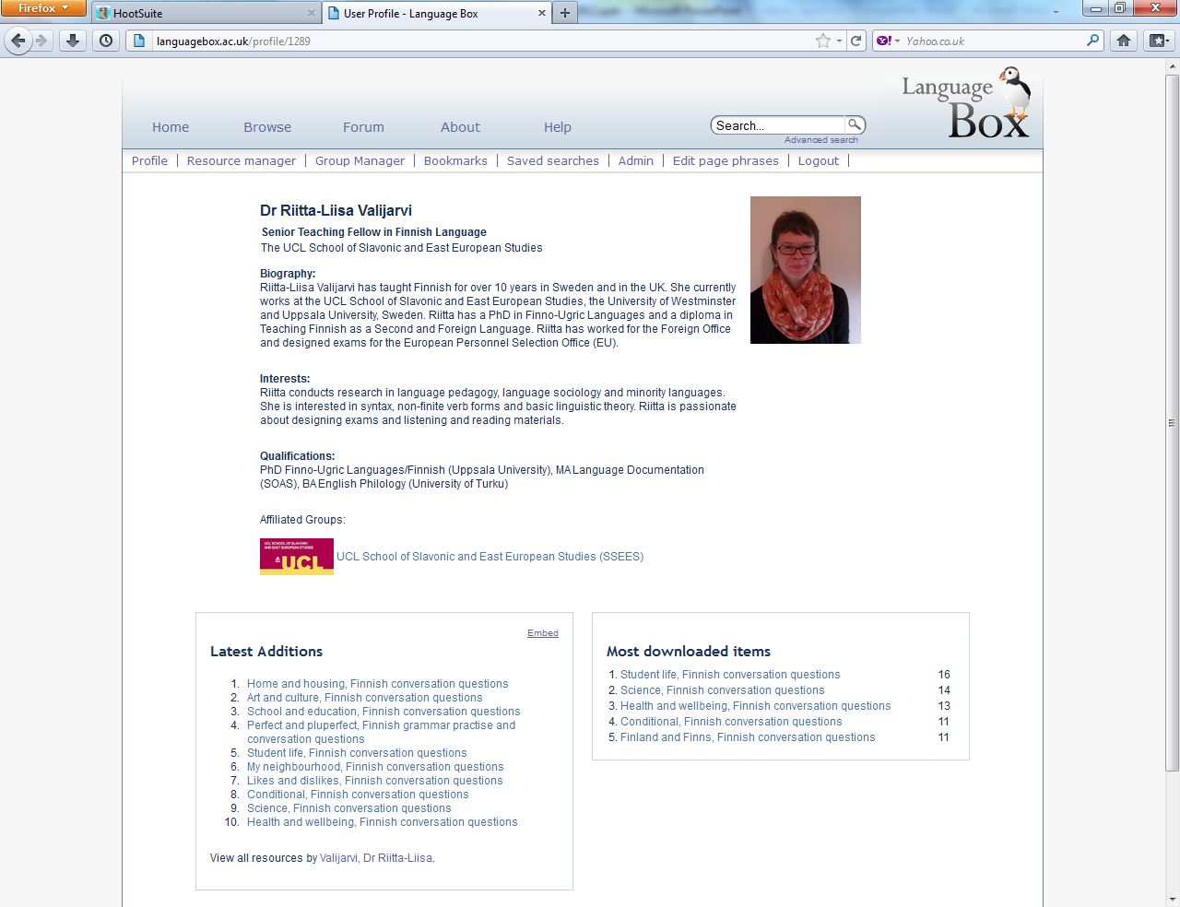

Slide 9
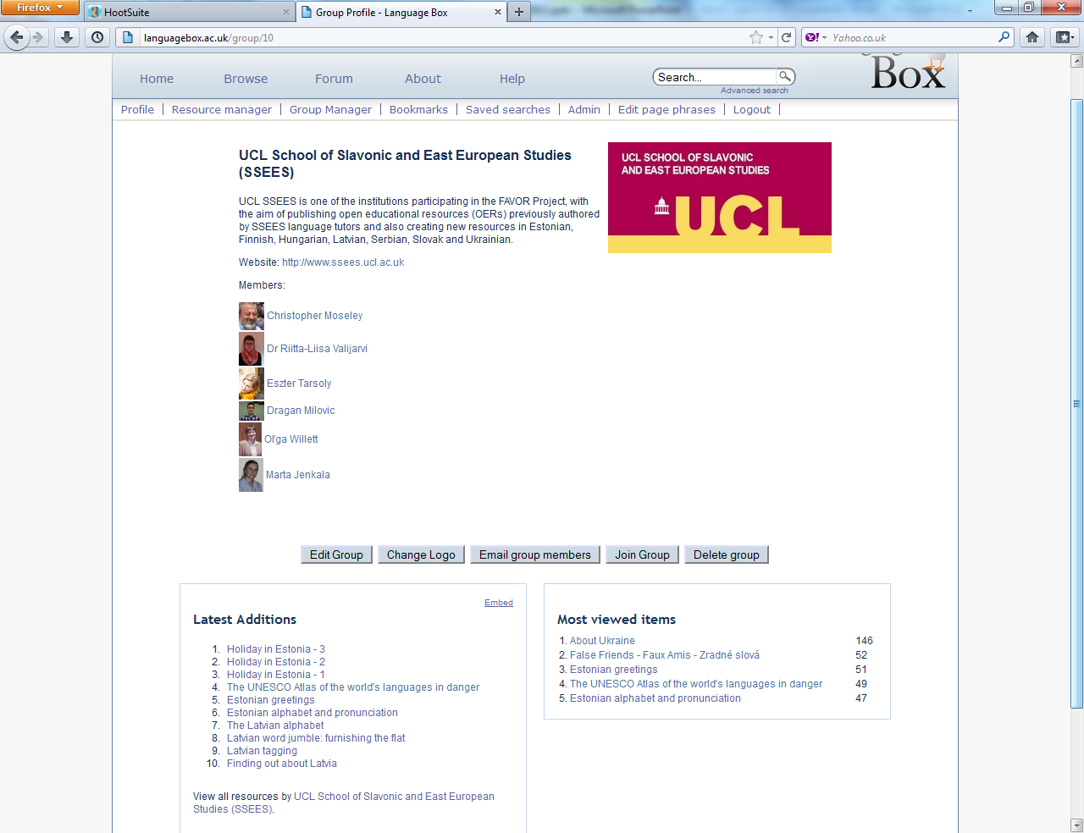
Notes:
Here we are – there is the UCL logo, and I can see the members of the group – if I clicked on their names, I could see their profile pages. I can see which resources have been uploaded as part of this group…and if I wanted to, I could click ‘join group’ and I could join it!
The LanguageBox is an open site, which anyone can join and start sharing their work through. Anyone is free to set up groups too – and some of the tutors are intending to set up their own interest groups around the languages that they teach. Wambui has done this for Swahili – so if you teach or learn Swahili, you may wish to join that group!
So.. Phase 1 – which is about sharing existing resources has moved into phase 2 – creating new resources.

Slide 10
Findings
Tutors have enjoyed the process of sharing their work and preparing it for open publication
Engaging with open practice has been easier than expected
Obstacles to staff engaging in small projects are staggering and should be addressed

Slide 11
Concluding remarks
Open practice has potential for hourly-paid/part-time tutors:
for professional development in a range of ways, from profile-raising; encouraging reflection on current practice, to enhancing digital literacy
there is enhanced usefulness if part of a community of collegiate ‘sharers’
benefits for full engagement (sharing your work and downloading) and for partial (browsing, downloading others’ work)

Slide 12
How can I get involved?
Join a community repository such as LanguageBox
Create a profile
Browse the site and bookmark resources you like
Share ‘tasters’ of your own work
Set up a group and appeal for others with similar interests to join and share their work; set up a group for your own institution or team

Slide 13
Useful links for info and advice (OERs)
OER Infokit: http://bit.ly/oerinfokit
The JISC (funding, OER projects): www.jisc.ac.uk
Open Courseware Consortium: www.ocwconsortium.org
Some repositories:
Jorum: www.jorum.ac.uk
HumBox: www.humbox.ac.uk
LanguageBox: http://languagebox.ac.uk
LORO (Language Open Resources Online): http://loro.open.ac.uk/

Slide 14
Useful links: landscape for languages
Coleman, J. 2004, Modern Languages in British universities: past and present, Arts and Humanities in Higher Education, 3(2), 147–162.
Klapper, J. 2006, Understanding and Developing Good Practice: Language Teaching in Higher Education. London: CILT.
Howarth, P. 2011, Language Centres and Academic Departments. Available online: http://www.ucml.ac.uk/shapingthefuture/identity
Review of Modern Foreign Languages provision in higher education in England, HEFCE, by M. Worton: http://www.hefce.ac.uk/pubs/hefce/2009/09_41/

