Slide 1
Directions

Slide 2
Lesson Objectives
In this lesson we will learn:
Prepositions
Ordinal numbers
How to give and ask for directions

Slide 3
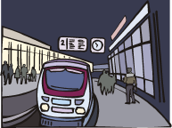
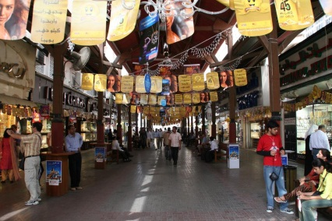
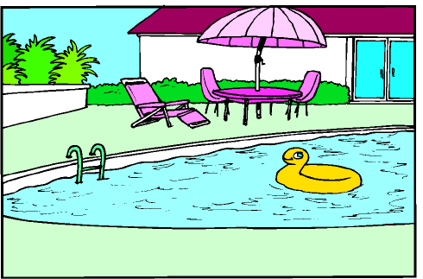
Recap: Places
Put the right word under the right image
Hadiiqa - matHaf - suuq - masbaH - funduq - maHaTTatu (a)lqiTaar -
masraH

Slide 4
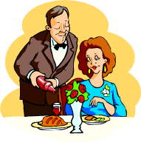
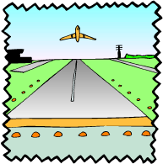
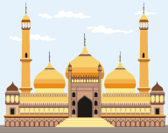
maTaar - maT3am - manzil/bayt - markazu (a)lmadiina - jaami3a - masjid - kaniisa

Slide 5
Prepositions
بِجَانِب= bijaanib
Next to
عَلَى= 3alaa
On
فِي= fii
In
أَمَامَ= amaam
In front of
فَوْقَ= fawq
Above
تَحْتَ = taHt
Under

Slide 6
أَيْنَ يُوجَدُ ...؟ = ayna yuujadu…? = Where is…? (masculine)
أَيْنَ تُوجَدُ...؟ = ayna tuujadu…? = Where is…? (feminine)

Slide 7
أَيْنَ يُوجَدُ السُّوق؟
ayna yuujadu (a)ssuuq?
Where is the market?
السُّوق يُوجَدُ بِجَانِب مَحَطَّة الْقِطَار
assuuq yuujadu bijaanib maHaTTat alqiTaar
The market is (found) in front of the train station

Slide 8
Ordinal numbers
1st 2nd 3rd 4th 5th
6th 7th 8th 9th 10th
أَوَّل
awwal
ثَانِي
thaanii
ثَالِث
thaalith
رَابِع
raabi3
خَامِس
khaamis
سَادِس
saadis
سَابِع
saabi3
تَاسِع
taasi3
عَاشِر
3aashir
ثَامِن
thaamin

Slide 9
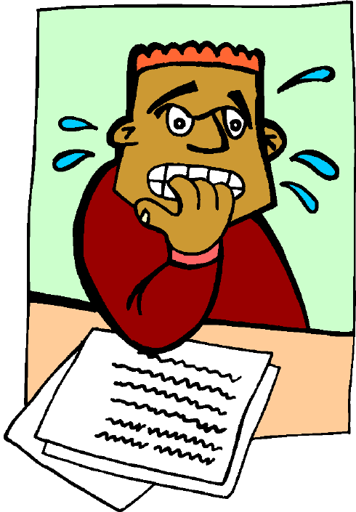
Test your memory by inserting the missing vowels from each word
1st 2nd 3rd 4th 5th
6th 7th 8th 9th 10th
- ww - l
th - - n- -
Th - - l - th
R - - b - 3
Kh - - m - s
S - - d - s
S - - b - 3
Th - - m - n
T - - s - 3
3 - - sh - r

Slide 10
Directions
Key words
إِذْهَبْ عَلَى طُول idhab 3alaa Tuul go straight on
عَلَى الْيَمِين 3alaa (a)lyamiin on the right
عَلَى الْيَسَار 3alaa (a)lyasaar on the left
شَارِع shaari3 street
إِشَارَة الْمُرُور ishaarat (a)lmuruur traffic lights
خُذْ khud take (male)
خُذِي khudii take (female)
أَوَّل شَارِع awwal shaari3 first street
ثَانِي شَارِع thaanii shaari3 second street

Slide 11
To ask for directions
أَيْنَ الْمَتْحَف مِنْ فَضْلِك؟
ayna (a)lmatHaf, min faDlik?
Where is the museum, please?
Or
لَوْ سَمَحْت, الْمَتْحَف مِنْ أَيْن؟
law samaHt, almatHaf min ayna?
Excuse me, how do I get to the museum?

Slide 12
To give directions
Example
idhab 3alaa Tuul, khud thaalith shaari3 3alaa (a)lyasaar. almatHaf amaama funduq shiratun
Go straight on, take the third street on the left. The museum is in front of Sheraton hotel.

Slide 13
How would you ask for and give the following directions?
1- Salam hotel:
, take the 2nd street , the Salam hotel is next to the theatre.
2- Church:
Take the 1st street , at the traffic lights, the church is in the city centre

Slide 14
Listening
Listen to each audio and decide which place and directions are given. The star is the starting point
Example:
Place : museum
Place 1 place 2 place 3

