Slide 1

Places and transports
By Ghizlane Lafdi

Slide 2
Lesson objectives
In this lesson we will learn:
Different places
How to describe places
3. Different types of transports
By Ghizlane Lafdi

Slide 3
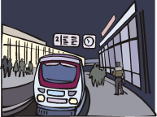

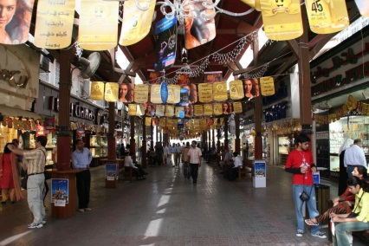


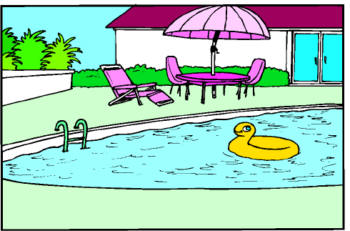


Places = amaakin = أَمَاكِن
مَحَطَّةُ ُالْقِطَار
maHaTTatu (a)lqiTaar
Train station
مَتْحَف
matHaf
Museum
سُوق
suuq
market
مَسْرَح
masraH
Theatre
مَسْبَح
masbaH
Swimming pool
فُنْدُق
funduq
Hotel
حَدِيقَة
Hadiiqa
Park /garden
By Ghizlane Lafdi

Slide 4
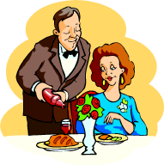

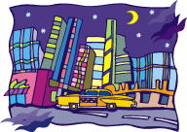
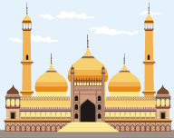



مَطْعَم
maT3am
Restaurant
مَطَار
maTaar
Airport
مَرْكَزُ الْمَدِينَة
markazu (a)lmadiina
City centre
مَسْجِد
masjid
Mosque
كَنِيسَة
kaniisa
Church
جَامِعَة
jaami3a
University
مَنْزِل/ بَيْت
manzil/bayt
House
By Ghizlane Lafdi

Slide 5
Irregular plural
Singular | Plural | English
maHaTTatu (a)lqiTaar matHaf suuq masraH masbaH funduq Hadiiqa maT3am kaniisa masjid maTaar manzil bayt jaami3a | maHaTTaatu (a)lqiTaar mataaHif aswaaq masaariH masaabiH fanaadiq Hadaa’iq maTaa3im kanna’is masaajid maTaaraat manaazil buyuut jaami3aat | Train station(s) Museum(s) Market(s) Theatre(s) Swimming pool(s) Hotel(s) Park(s)/garden(s) Restaurant(s) Church(es) Mosque(s) Airport(s) House(s) House(s) / home(s) University(ies)
By Ghizlane Lafdi

Slide 6

Adjectives to describe places
kabiir # Saghiir
Big # small
مَنْزِل كَبِير= manzil kabiir = a big house
مَنَازِل كَبِيرَة = manaazil kabiira = big houses
مَنْزِل صَغِير = manzil Saghiir = a small house
مَنَازِل صَغِيرَة = manaazil Saghiira = small houses
By Ghizlane Lafdi

Slide 7

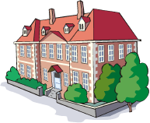
jadiid # qadiim
New # old
مَنْزِل قَدِيم = manzil qadiim = an old house
مَنَازِل قَدِيمَة = manaazil qadiima = old houses
مَنْزِل جَدِيد = manzil jadiid = a new house
مَنَازِل جَدِيدَة = manaazil jadiida = new houses
By Ghizlane Lafdi

Slide 8
rakhiiS # ghaalin
Cheap # expensive
مَنْزِل رَخِيص = manzil rakhiiS = a cheap house
مَنَازِل رَخِيصَة = manaazil rakhiiSa = cheap houses
مَنْزِل غَالٍ = manzil ghaalin = An expensive house
مَنَازِل غَالِيَة = manaazil ghaaliya = expensive houses
By Ghizlane Lafdi

Slide 9

jamiil # bashi3
Beautiful # ugly
حَدِيقَة بَشِعَة = Hadiiqa bashi3a = An ugly garden
حَدَائِق بَشِعَة = Hadaa’iq bashi3a = ugly gardens
حَدِيقَة جَمِيلَة = Hadiiqa jamiila = A beautiful garden
حَدَائِق جَمِيلَة = Hadaa’iq jamiila = beautiful gardens
By Ghizlane Lafdi

Slide 10
How would you say the following sentences in Arabic?
A big mosque / big mosques
A small university / small cities
An old church/ old churches
A cheap market/ cheap markets
A new theatre/ new theatres
An expensive hotel/ expensive hotels
A nice theatre/ beautiful theatres
An ugly museum/ ugly museums
By Ghizlane Lafdi

Slide 11
!
!
It is important to note that adding a definite article to the described word or to both the described word and to the adjective itslef changes the meaning of a sentence.
Example:
مَدِينَة قَدِيمَة = madiina qadiima = an old city
الْمَدِينَة قَدِيمَة = almadiina qadiima = the city is old
الْمَدِينَة الْقَدِيمَة = almadiina alqadiima = the old city
By Ghizlane Lafdi

Slide 12
مَاذَا يُوجَدُ فِي مَدِينَتِكَ / كِ؟
maadaa yuujadu fii madiinatika / ki?
What is found in city-your (male/female)
What is found in your city?
By Ghizlane Lafdi

Slide 13
فِي مَدِينَتِي هُنَاكَ مَتَاحِف قَدِيمَة
In city-my there museums old
In my city there are old museums
By Ghizlane Lafdi

Slide 14

مَاذَا يُوجَدُ فِي مَدِينَتِكَ / كِ؟
maadaa yuujadu fii madiinatika / ki?
What is found in your city?
By Ghizlane Lafdi

Slide 15






Transports = wasaa’ilu (a)nnaql = وَسَائِلُ النَّقْل
حَافِلَة= Haafila
Bus
قِطَار= qiTaar
Train
سَيَّارَة= sayyaara
Car
سَيَّارَة أُجْرَة= sayyarat ujra
Taxi
دَرَّاجَة= darraaja
Bicycle
طَائِرَة= Taa’ira
Plane
By Ghizlane Lafdi

Slide 16

Test your memory
By putting the letters in the right order
filaHaa
Taarqi
rasayyaa
ujra sayyarat
jadarraa
raTaa’i
By Ghizlane Lafdi

Slide 17
Note:
To say by + means of transport you need to add ‘bi’ to the transport in
Arabic. For instance: by train = bi-(a)lqiTaar = بِالْقِطَار
By car bi-(a)ssayyara بالسَّيَّارَة
By train bi-(a)lqiTaar بِالْقِطَار
By bicycle bi-(a)ddarraaja بِالدَّرَّاجَة
By plane bi-(a)TTaa’ira بِالطَّائِرَة
By bus bi-(a)lHaafila بِالْحَافِلَة
By foot/ I walk atamashshaa أَتَمَشَّى
By Ghizlane Lafdi

Slide 18
كَيْفَ تَذْهَبِين إِلَى الْجَامِعَة؟
kayfa tadhabiin ilaa (a)ljaami3a?
How do you go to univerity?
أَذْهَبُ إِلَى الْجَامِعَة بِالْحَافِلَة
adhabu ilaa (a)ljaami3a bi-(a)lHaafila
I go to university by bus
By Ghizlane Lafdi

Slide 19
وَأَنْتَ , كَيْفَ تَذْهَبُ إِلَى الْجَامِعَة؟
wa anta, kayfa tadhabu ilaa (a)ljaami3a?
And you, how do you go to university?
أَنَا أَتَمَشَّى إِلَى الْجَامِعَة
anaa atamashshaa ilaa (a)ljaami3a
I walk to university
By Ghizlane Lafdi

Slide 20
وَأَنْتَ , كَيْفَ تَذْهَبُ إِلَى الْجَامِعَة؟
wa anta, kayfa tadhabu ilaa (a)ljaami3a?
And you, how do you go to university?
By Ghizlane Lafdi

Slide 21
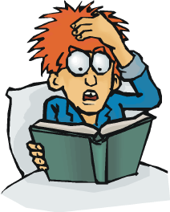
Reading:Arabic script
إِسْمِي لَيْلَى وَأَنَا مِصْرِيَّة. أَسْكُنُ فِي الْقَاهِرَة. فِي مَدِينَتِي
هُنَاكَ مَطَار جَدِيد, وَمَسَاجِد كَبِيرَة, وَمَتْحَف قَدِيم. هُنَاكَ أَيْضاً
مَطَاعِم غَالِيَة وَأَسْوَاق رَخِيصَة. وَلَكِن هُنَاكَ مَحَطَّة قِطَار
بَشِعَة. أُحِبُّ مَدِينَتِي لِأَنَّهَا جَمِيلَة.
أَنَا أدْرُسُ فِي الْجَامِعَة وَأَذْهَبُ إِلَى الْجَامِعَة بِالدَّرَّاجَة, وَلَكِن
صَدِيقَتِي تَذْهَبُ إِلَى الْجَامِعَة بِالْحَافِلَة.
By Ghizlane Lafdi

Slide 22
Reading: transliteration
ismii laylaa wa anaa miSriyya. askunu fii (a)lqaahira. fii madiinatii hunaaka maTaar jadiid wa masaajid kabiira wa matHaf qadiim. hunaaka ayDan maTaa3im ghaaliya wa aswaaq rakhiiSa. wa lakin hunaaka maHaTTat qiTaar bashi3a. anaa uHibbu madiinatii li’annahaa jamiila.
anaa adrusu fii (a)ljaami3a wa adhabu ilaa (a)ljaami3a bi’addarraaja wa lakin Sadiiqatii tadhabu ilaa (a)ljaami3a bi-alHaafila.
By Ghizlane Lafdi

Slide 23
Questions
1- what can be found in Fatima’s city?
2- Does Fatima like her city? Why?
3- How does Fatima go to university?
4- How does Fatima’s friend go to university?
By Ghizlane Lafdi

Slide 24

Homework
Write, in Arabic script, a letter to an Arab penfriend in which you give information about yourself (name, age, work, family…etc) and your town.
By Ghizlane Lafdi

