Slide 1
Shopping for clothes and food

Slide 2
Lesson objectives
In this lesson we will learn:
Clothes and colours
Fruits and vegetables
Ask the price of items of food and clothes

Slide 3

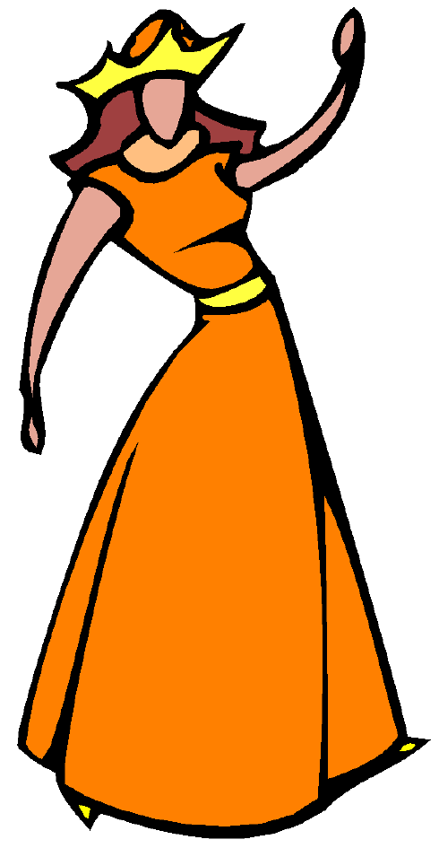

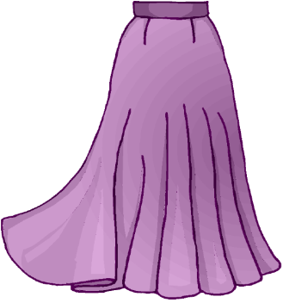
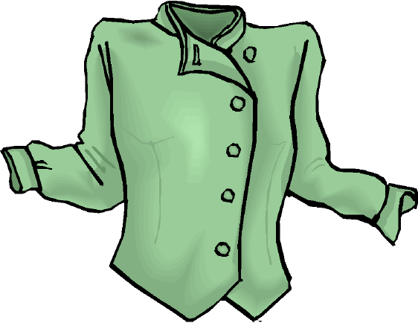
Clothes = malaabis = مَلاَبِس
سِرْوَال= sirwaal
Trousers
فُسْتَان= fustaan
Dress
تَنُّورَة= tannura
Skirt
قَمِيص= qamiiS
Shirt

Slide 4
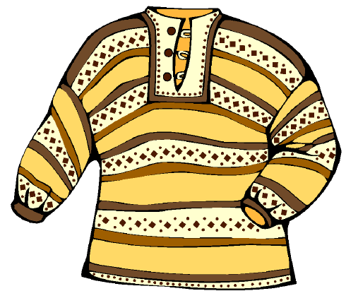


كَنْزَة = kanza
Jumper
حَقِيبَة = Haqiiba
Handbag
حِذَاء = Hidaa’
Shoes
قُبَّعَة = qubba3a
Hat

Slide 5

Test your memory
By putting the jumbled letters in the right order
waalsir
zakan
baHaqii
taanfus
ratannuu
daa’Hi
3aqubba
miiSqa

Slide 6
Colours = alwaan = أَلْوَان
aswad
akhDar
sawdaa’
khaDraa’
Black
Green
abyaD
burtuqaaliyy
bayDaa’
burtuqaaliyya
White
Orange

Slide 7
banafsajiyy
aHmar
banafsajiyya
Hamraa’
purple
Red
aSfar
safraa’
yellow
bunniyy
azraq
bunniyya
zarqaa’
Brown
Blue

Slide 8
Test your memory
by writing the missing vowels
Blue
-zr-q
Red (feminine)
H-mr--’
Yellow
-Sf-r
Purple
b-n-fs-j-yy
Green
-khD-r
Black (feminine)
s-wd- -’

Slide 9
To wear = yalbasu = يَلْبَسُ
أَلْبَسُ تَنُّورَة بَنَفْسَجِيَّة وَقَمِيص أَخْضَر
albasu tannuura banafsajiyya wa qamiiS akhDar
I wear skirt purple and shirt green
I wear a purple skirt and a green shirt

Slide 10

wa anta, maadaa talbas(u)?
And you, what do you wear?

Slide 11
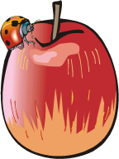





Fruits and vegetables
tuffaaH
Apple
baTaaTis
Potatoes
burtuqaal
Orange
TamaaTim
Tomatoes
muuz
banana
jazar
Carrots

Slide 12
At the shop
Key words
urridu I’d like/ I want
mumkin I want/ (is it possible?)
kiiluu kilo
niSf kiiluu hald a kilo
hal tabii3(u)…? do you sell…?
bikam? how much ?
tafaDDal/tafaDDalii here you are (masculine/feminine)

Slide 13
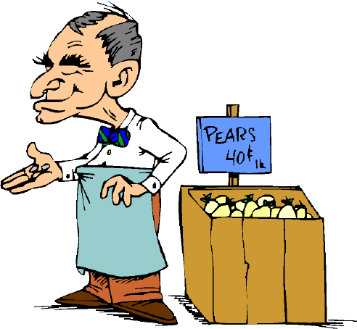

hal tabii3u (a)lbaTaaTis?
Do you sell potatoes?
na3am
Yes

Slide 14
uriidu niSf kiiluu baTaaTis, min faDlik(a)
I’d like half a kilo of potatoes, please
tafaDDal
Here you are

Slide 15
3ishruun dirham
20 dirhams
bikam?
How much?

Slide 16
shukran
Thanks
tafaDDal

Slide 17
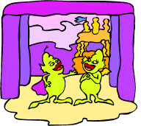
Role play
How would you buy the following items?
1kg (30 dirhams)
½ kg ( 15 dirhams)
100 g (4 dirhams)

Slide 18
Translate the following questions into Arabic
bikam hadaa alHidaa’ alaswad?
How much are these shoes?
Example:
How much is this orange dress?
How much is this brown handbag?
How much is this yellow hat?
How much is this black trousers?

Slide 19
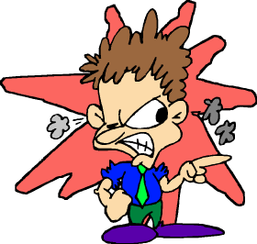
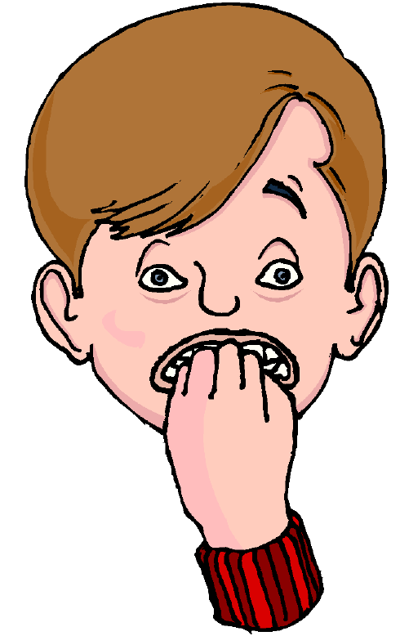
Homework
Write the following sentences in the Arabic script. (Check your answer with your teacher)
albasu tannuura bayDaa’
fustaan azraq
uriidu kiiluu muuz, min faDlika

