Slide 1
aTTa3aam wa almashruubaat
Food and Drinks

Slide 2
Lesson Objectives
In this lesson we will learn:
Some food and drinks
Express your likes and dislikes
Order food and drinks in a restaurant

Slide 3




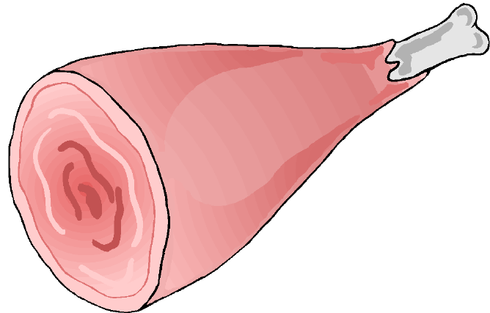

Food = Ta3aam = طعَام
بَيْض = bayD
Egg
لَحْم بَقَر = laHm baqar
Beef
سَمَك = samak
Fish
لَحْم خَرُوف = laHm kharuuf
دَجَاج = dajaaj
Chicken
Lamb

Slide 4

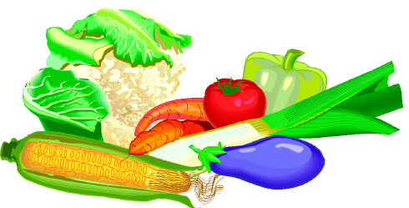



فَوَاكِه= fawaakih
Fruits
خُضَر = khuDar
Vegetables
سُكَّر = sukkar
خُبْز = khubz
Bread
أَرُز = aruzz
Rice

Slide 5
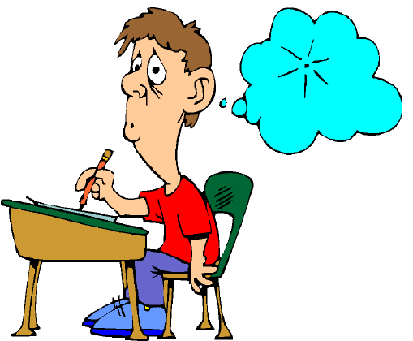


Test your memory
By putting the letters in the right order
Hmla qarba
yDba
aksam
jaajda
Hmla ruufkha

Slide 6
kihfawaa
Darkhu
kkarsu
zkhub
uzzar

Slide 7
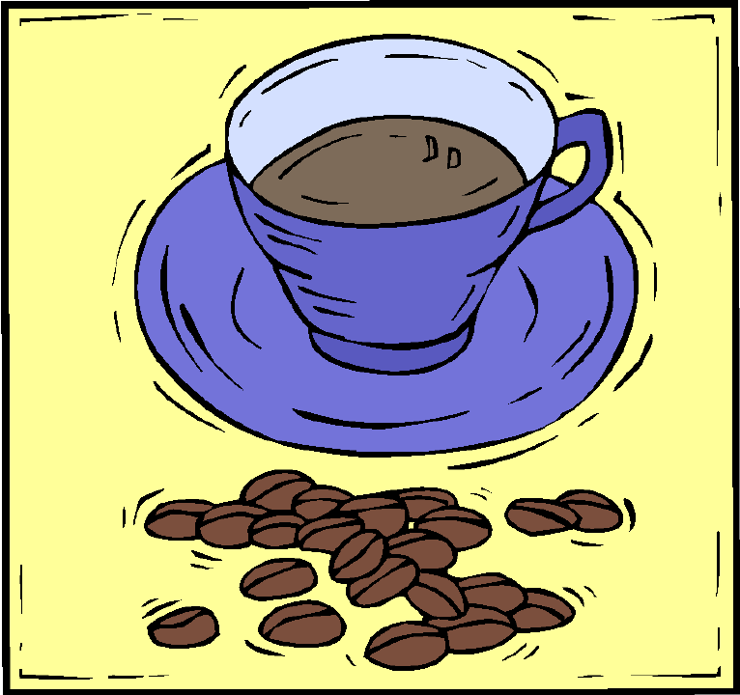
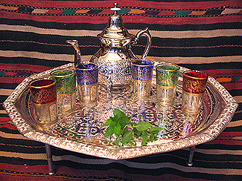
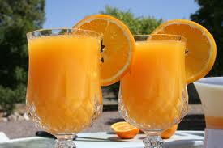

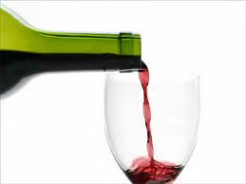
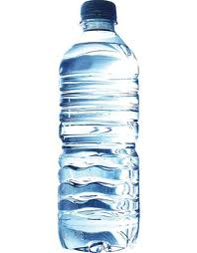
Drink(s) = mashruub(aat) = مَشْرُوبَات
قَهْوَة = qahwa
Coffee
شَاي = shaay
Tea
عَصِير بُرْتُقَال = 3aSiir burtuqaal
Orange juice
عَصِير تُفَّاح3aSiir tuffaH
apple juice
نَبِيذ = nabiid
Wine
مَاء = maa’
Water

Slide 8
Test your memory
By putting the letters in the right order
Test your memory
waqah
yasha
Siir3a qaalburtu
Siir3a ffaHtu
biidna
aa’m

Slide 9

Expressing Likes and dislikes
uHibbu = I like/I love
laa uHibbu = I don’t like
akrahu = I hate

Slide 10
anaa uHibbu addajaaj wa (a)lkhuDar
I like (the) chicken and (the) vegetables

Slide 11
anaa laa uHibbu assamak wa (a)llaHm
I do not like (the) fish and (the) meat

Slide 12
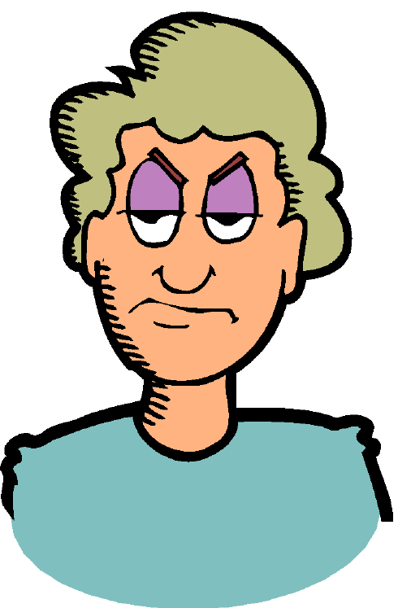
anaa akrahu albayD wa (a)laruzz
I hate (the) eggs and (the) rice

Slide 13

wa anta/anti, maadaa tuHibbu/tuHibbiin?
And you, what do you like (male/female)?

Slide 14
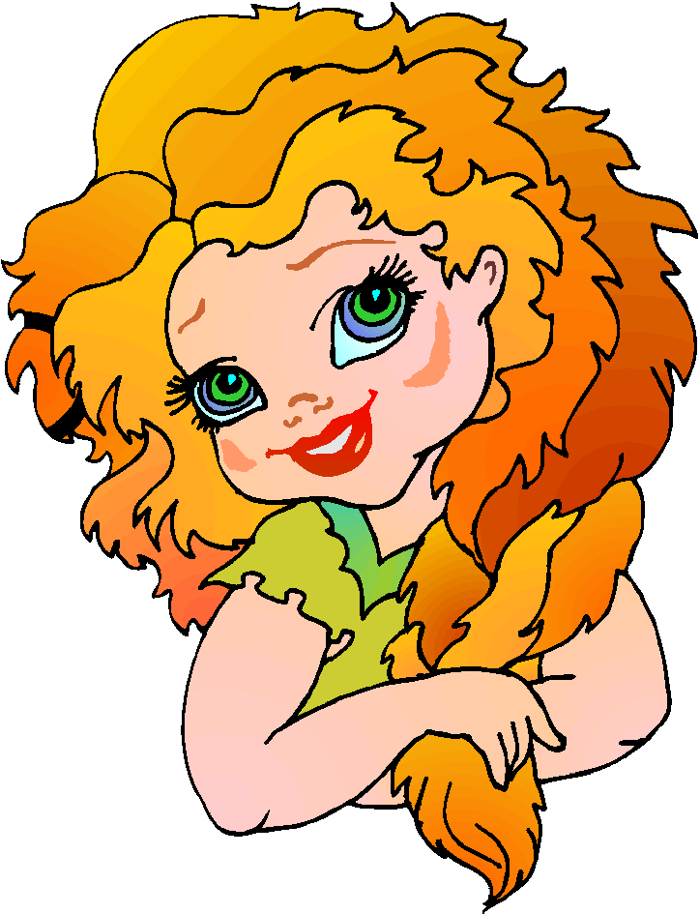
maa huwa mashruubuka/ki almufaDDal?
What is(he) drink (your) favourite
What is your favourite drink?
mashruubii almufaDDal huwa 3aSiir alburtuqaal
My favourite drink is orange juice

Slide 15
maa huwa mashruubuka/ki almufaDDal?
What is your favourite drink?

Slide 16
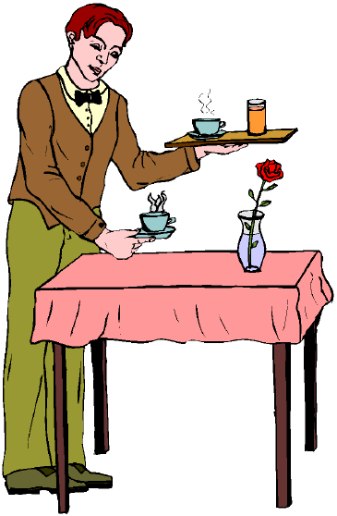
At the restaurant = fii almaT3am
Key words
uriidu I would like/ I want
mumkin I want/(is it possible)
min faDlika/faDliki please (male/female)
tafaDDal/tafaDDalii here you are (male/female)
alHisaab the bill

Slide 17
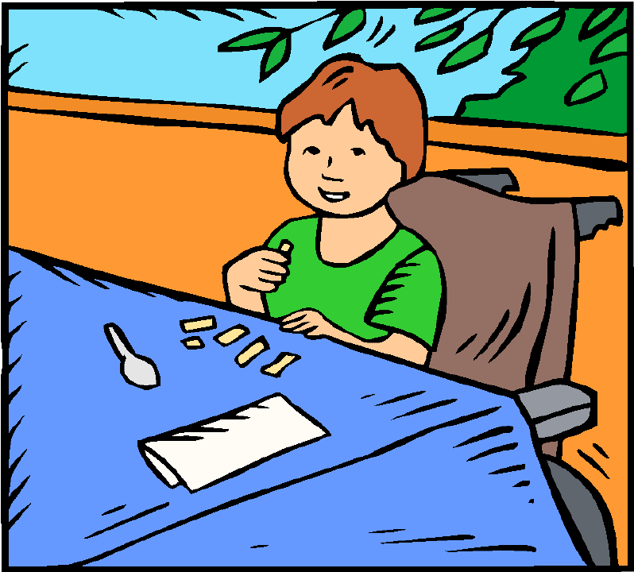
uriidu dajaaj wa aruzz, min faDlik(a)
I would like coffee and cookies, please
na3am aanisatii?
Yes Madam?

Slide 18
na3am,wa maadaa ayDan, aanisatii?
Yes, what else, Madam?
mumkin 3aSiir tuffaaH wa maa’, min faDlik(a)?
I would like apple juice and water, please

Slide 19
shukran….
alHisaab min faDlik(a)
Thank you…
The bill, please!
tafaDDalii, aanisatii
Here you are Madam

Slide 20



Listening
Listen to three customers ordering food and drinks and tick the right items
Customer 1
Customer 2
Customer 3

Slide 21
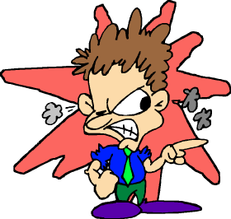
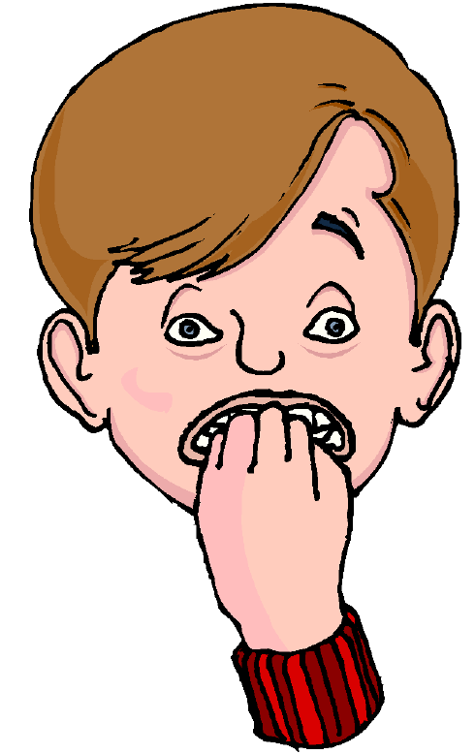
Homework
Write the following sentences in the Arabic script. (Check your answer with your teacher)
uHibbu alqahwa
laa uHibbu alkhuDar
akrahu assamak
mashruubii almufaDDal huwa 3aSiir attuffaaH

