Slide 1
Jobs and places of work

Slide 2
Lesson Objectives
In this lesson we will learn:
Different jobs and places of work
Definite article
Verbs ‘to work’ and ‘to study’

Slide 3

Job = 3amal = عَمَل
Tabiib(a)
Doctor (female)
mudarris(a)
Teacher
Tabbaakh(a)
Cook
Taalib(a)
Student
muHaasib(a)
Accountant
muhandis(a)
Engineer

Slide 4


Places of work
mustashfaa
hospital
madrasa
school
maT3am
Restaurant
jaami3a
Univerity
bank
Bank
sharika
Company

Slide 5

Grammar: Definite articles
With moon letter: the= al = الْ
The teacher = almudarris = الْمُدَرِّس
With sun letter: the = a = ال
The doctor = aTTabiib = الطَّبِيب

Slide 6
Sun Letters
ت
ث
د
ذ
ر
ز
س
ش
ص
ض
ط
ظ
ن

Slide 7
Task
With the help of the list of the sun letters, attach the appropriate definite article (al or a) to the words on slides 3 and 4.

Slide 8
- ayna ya3malu aTTabiib?
Where works the doctor (male)
Where does the doctor work?
- attabiib ya3malu fii almustashfaa
the doctor works in the hospital
The doctor works in the hospital

Slide 9
- ayna ta3malu aTTabiiba?
Where works the doctor (female)
Where does the doctor work?
attabiiba ta3malu fii almustashfaa
the doctor works in the hospital
The doctor works in the hospital

Slide 10
Task
Translate the following sentences into Arabic. Provide both the masculine and feminine form.
1- the cook works in a restaurant
2- the teacher works in a school
3- the accountant works in a bank

Slide 11
Grammar: present tense
To work = ya3malu = يَعْمَلُ
(anaa) a3mal(u) (naHnu) na3mal(u)
(I/me) work (we) work
(anta) ta3mal(u) (antum) ta3maluun(a)
(you male) work (you/male/ plural) work
(anti) ta3maliin(a) (antunna) ta3maln(a)
(you female) work (you/female/plural) work
(huwa) ya3mal(u) (hum) ya3maluun(a)
(he/him) work (they/male) work
(hiya) ta3mal(u) (hunna) ya3maln(a)
(she/her) work (they/female) work

Slide 12
Grammar: present tense
Follow the pattern of the verb ‘to work’ on slide 11 to conjugate the verb ‘to study’
To study = yadrusu = يَدْرُسُ
anaa naHnu
anta antum
anti antunna
huwa hum
hiya humaa

Slide 13
Talking about yourself and your family
laa, anna laa a3mal(u).
anna Taalib.
No, I do not work. I am a student
hal ta3mal(u)?
Do you work?

Slide 14
abii ya3mal(u) muHaasib fii bank. maa 3amalu ummiki?
My father works as an accountant in a bank. What does your mother do for a living?
maa 3amalu abiika?
What does your father do for a living?

Slide 15
ummi mudarrisa wa hiya ta3malu fii madrasa.
My mother, she is a teacher and works in a school.

Slide 16

wa anta, maa 3amaluka?
And you, what do you do for a living?

Slide 17
Task
Answer the following questions in Arabic
1- maa 3amalu abiika?
2- ayna ya3malu abuuka?
3- maa 3amalu ummika?
4- ayna ta3malu ummuka?
5- maa 3amaluka?

Slide 18

Reading:Arabic script
أَنَا إِسْمِي فَاطِمَة وَأَسْكُنُ فِي مُرَّاكُش, مَدِينَة فِي الْمَغْرِب وَلَكِن أَنَا مِصْرِيَّة. عُمْرِي عِشْرُون سَنَة وَأَنَا طَالِبَة فِي الْجَامِعَة. أُمِّي إِسْمُهَا أَمِينَة وَعُمْرُهَا خَمْسَة وَأَرْبَعُون سَنَة. هِيَ لاَ تَعْمَل. أَبِي عُمْرُهُ خَمْسُون سَنَة وَهُوَ طَبِيب وَيَعْمَلُ فِي مُسْتَشْفَى. عِنْدِي أُخْت وَاحِدَة وَأَخ وَاحِد. أُخْتِي إِسْمُهَا مَرْيَم وَعُمْرُهَا ثَمَانِيَةَ عَشَر سَنَة . هِيَ تَدْرُسُ فِي مَدْرَسَة. أَخِي إِسْمُهُ أَحْمَد وَعُمْرُهُ سِتَّة وَعِشْرُون سَنَة. هُوَ يَعْمَلُ مُحَاسِب فِي بَنْك

Slide 19
Reading: transliteration
anaa ismii faaTima wa askunu fii murrakush, madiina fii almaghrib wa
lakin anaa miSriyya. 3umrii 3ishruun sana wa anaa Taaliba fii aljaami3a.
ummii ismuhaa amiina wa 3umruhaa khamsa wa arba3uun sana. hiya
laa ta3mal. abii 3umruhu khamsuun sana wa huwa Tabiib wa ya3malu fii
mustashfaa. 3indii ukht waaHida wa akh waaHid. ukhtii ismuhaa
maryam wa 3umruhaa thamaaniyata 3ashar sana. hiya tadrusu fii
almadrasa. akhii ismuhu aHmad wa 3umruhu sitta wa 3ishruun sana.
huwa ya3malu muHaasib fii bank.

Slide 20

Answer the following questions
1- What is Fatima’s nationality
2- How old is Fatima and what does she do for a living?
3- How old is Fatima’s mother and what does she do for a living?
4- How old is Fatima’s sister and what does she do for a living?
5- How old is Fatima’s brother and does he do for a living?

Slide 21

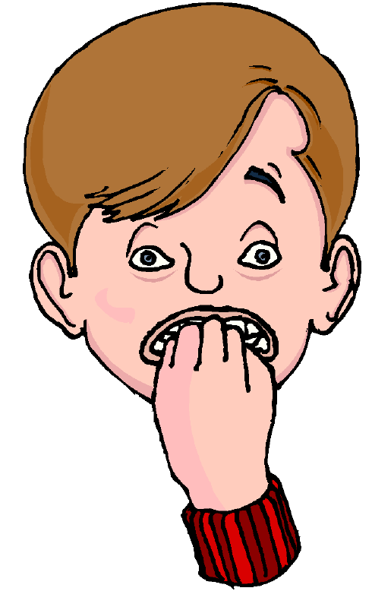
Homework
Write the following sentences in the Arabic script. (Check your answer with your teacher)
Example: almuHaasib ya3malu fii bank
1- aTTaBBaakh ya3malu fii maT3am
2- almuhandisa ta3malu fii sharika
3- aTTaalib yadrusu fii madrasa
4- anaa laa a3malu

