Slide 1
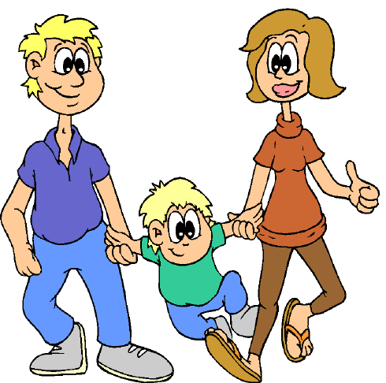
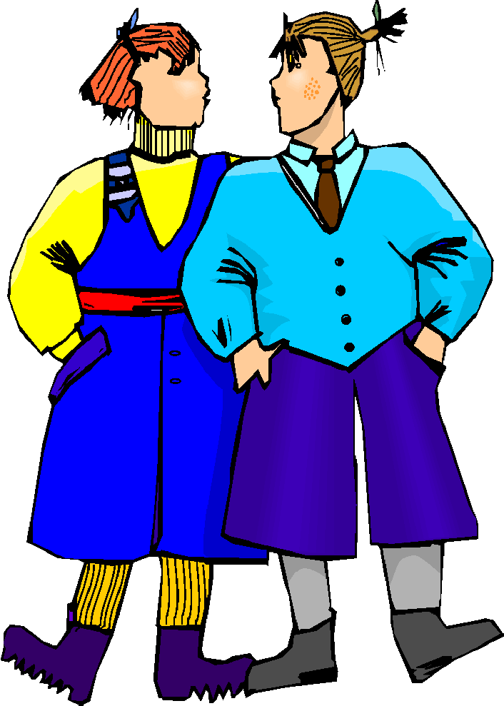
Family and friends

Slide 2
Lesson Objectives
In this lesson we will learn:
To talk about members of family and friends
Two forms of ‘this’
To use possessive adjectives (my, your, his, her)
Numbers from 20 to 100

Slide 3
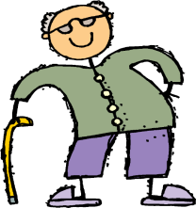

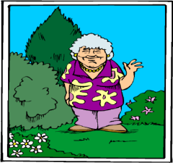
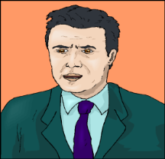
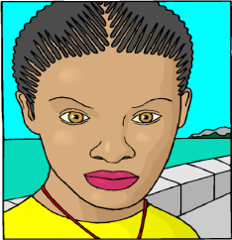
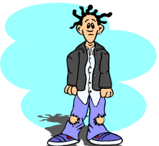
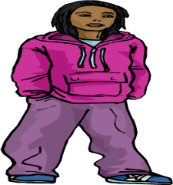

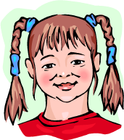
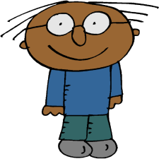
Family and friends
Jadd = Grandfather (aHmad)
Jadda=grandmother
amiina
ab = Father (3umar)
umm= mother
fatima
akh=Brother (samiir)
ukht = sister
(maryam)
Sadiiq= boyfriend
(Tom)
Sadiiqa = girlfriend
(Lisa)
anaa = me (Saliim)

Slide 4

ismii saalim wa hadihi usratii
Name-my Salim and this is family-my
My name is Salim and this my family

Slide 5

هَذَا = hadaa = this (male)
hadaa jaddii
this (is) grandfather-my
This is my grandfather

Slide 6
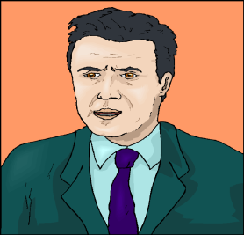
hadaa abii
this (is)father-my
This is my father

Slide 7
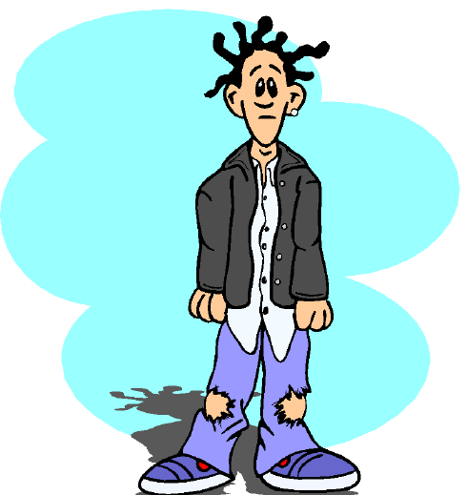
hadaa akhii
this (is) brother-my
This is my brother

Slide 8
How would you say?
This is my friend (male)

Slide 9
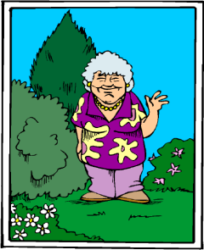
هَذِهِ = hadihi = this (female)
hadihi jaddatii
this (is)grandmother-my
This is my grandmother

Slide 10
hadihi ummii
this (is)mother-my
This is my mother

Slide 11
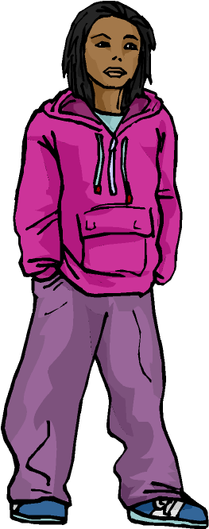
hadihi ukhtii
this (is) sister-my
This is my sister

Slide 12
How would you say?
This is my friend (female)

Slide 13
Do you have (male/female) any brothers or sisters?
hal 3indaka /3indaki ikhwa aw akhawaat?

Slide 14
na3am, 3indii akh waaHid wa ukht waaHida
Yes, Have-(my) brother one and sister one
Yes, I have one brother and one sister

Slide 15
laysa 3indii ikhwa aw akhawaat
Not have (my) brother or sisters
I do not have any brothers or sisters

Slide 16
maa ismu akhiika?
What name (of) brother-your
What is your brother’s name?
akhii ismuhu samiir
Brother-my name-his Sameer
My brother is called samiir

Slide 17
maa ismu ukhtika?
What name (of) sister-your
What is your sister’s name?
ukhtii ismuhaa maryam
Sister-my name-her Mariam
My sister is called Mariam

Slide 18
Recap: Possessive Adjectives
ismii name-my my name
ismuka name-your your name (masculine)
ismuki name-your your name (feminine)
ismuhu name-his his name
ismuhaa name-her her name
ismunaa name-our our name

Slide 19
Wa anta /anti, hal 3indaka/ 3indaki ikhwa aw akhawaat?
and you (male/female), do you have (male/female) brothers or sisters?
And you, have you got any brothers or sisters?

Slide 20
Task
Having learned the possessive adjectives, translate the following sentences into English
Example: abuunaa ismuhu Mohammad = our father is called Mohammad
My grandfather is called Ahmad
2. My girlfriend is called Selina
3. Her mother is called Fatima
4. Your (male) father is called Omar
5. Your (male) brother is called Sameer
6. Our brother is called Saalim

Slide 21

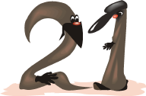










Numbers 20- 100
waaHid wa 3ishruun
sitta wa 3ishruun
ithnaani wa 3ishruun
sab3a wa 3ishruun
thalaatha wa 3ishruun
thamaaniya wa 3ishruun
arba3a wa 3ishruun
tis3a wa 3ishruun
khamsa wa 3ishruun
thalaathuun

Slide 22







arba3uun
sab3uun
thamaanuun
khamsuun
tis3uun
sittuun
mi’a

Slide 23
akhii 3umruhu khamsata 3ashar sana.
Brother-my age-his 15 year
My brother is 15 years old
kam 3umru akhiika?
what age (of) brother-your?
How old is your brother?

Slide 24
kam 3umru ummika?
How old is your mother?

Slide 25

Task: Role play
You are on holiday in Jordan and you meet somebody in the train station. You introduce each other in Arabic. (pay attention to gender!)
Lucy: good morning
Ahmad: good morning
Lucy: what’s your name?
Ahmad: my name’s Ahmad, and you, what’s your name?
Lucy: my name is Lucy
Ahmad: Where are you from?
Lucy: I am from Britain, I am British; and you, where are you from?
Ahmad: I live in Oman, in Jordan, but I am Palestinian

Slide 26
Lucy: how old are you?
Ahmad: I am 18 years old, and you, how old are you?
Lucy: I am 20 years old
Ahmad: do you have brothers or sisters?
Lucy: no, I do not have any brothers or sisters, and you, do you have brothers or sisters?
Ahmad: yes, I have one brother and one sister. My brother is called Mounir , he is 25 years old and my sister is called Ihssan and she is 32 years old.
Lucy: Nice to meet you, Ahmad
Ahmad: Nice to meet you Lucy

Slide 27
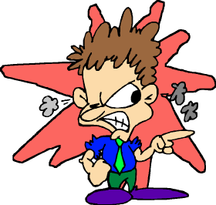
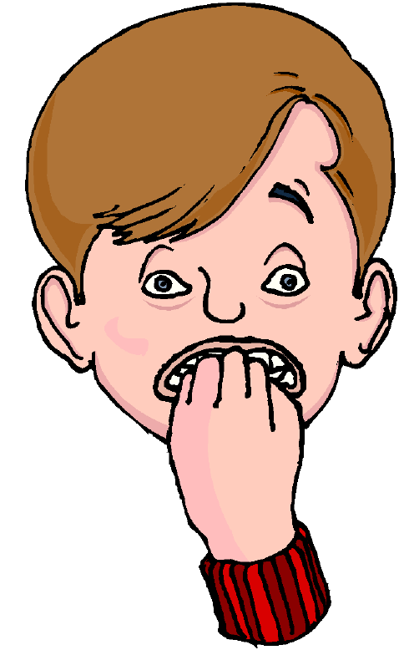
Homework
How would you write the following words and sentences in Arabic? (Check your writing with your teacher)
Example: grandfather = jadd =
grandmother = jadda =
abii ismuhu 3umar
ukhtii
akhii 3umruhu arba3a wa 3ishruun sana
My grandfather = jaddii
My grandmother= jaddatii

