Slide 1
Introducing yourself in Arabic

Slide 2
Lesson Objectives
In this lesson we will learn:
Different forms of greetings
To say your name and ask someone’s name in Arabic
Count to 20
Countries and nationalities
To say where you live

Slide 3

Popular forms of greetings
السَّلامُ عَلَيْكُم
assalaamu 3alaykum
(Peace be upon you)
وَعَلَيْكُمُ السَّلام
Wa3alaykumu-ssalaam
(Peace be upon you)

Slide 4
صَبَاحُ الْخَيْر
SabaaHu – lkhayr
Good morning
صَبَاحُ النُّور
SabaaHu-nnuur
Good morning (morning of light)

Slide 5
مَسَاءُ الْخَيْر
masaa’u – lkhayr
Good evening
مَسَاءُ النُّور
masaa’u-nnuur
Good evening (evening of light)

Slide 6
إِسْمِي سَمِير, وَأَنْتِ مَاإِسْمُكِ؟
ismii samiir, wa anti maa ismuki?
My name is Samir, and you what’s your name
مَاإِسْمُكَ؟
maa ismuka?
What’s your name

Slide 7
أَنَا إسْمِي فَاطِمَة
anaa ismii faaTima
Me, my name is Fatima
كَيْفَ حَالُكِ فَاطِمَة؟
kayfa Haaluki faaTima?
How are you Fatima

Slide 8
أَنَا بِخَيْر, وَأَنْتَ كَيْفَ
حَالُكَ؟
anaa bikhayr, wa anta kayfa Haaluka?
I am fine, and you how are you?
أَنَا بِخَيْر, شُكْرًا.
anaa bikhayr, shukran
I am fine, thank you.

Slide 9

فرصة سعيدة يا
سمير.
furSa sa3iida yaa samiir.
Nice to meet you Samir.
فرصة سعيدة يا فاطمة
furSa sa3iida yaa faaTima
Nice to meet you Fatima.

Slide 10
مع السلامة!
ma3a-ssalaama
Goobye!
مع السلامة!
ma3a-ssalaama!
Goodbye!

Slide 11
Test your memory by translating the following sentences into Arabic
Good morning
Good afternoon
What is your name? (female)
My name is …
How are you? (male)
I am fine, thanks, and you?
Nice to meet you
Bye!

Slide 12





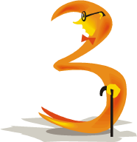





Numbers 1-10
waaHid
sitta
ithnaan
sab3a
thalaatha
thamaaniya
arba3a
tis3a
3ashara
khamsa

Slide 13


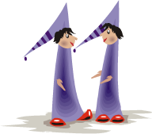







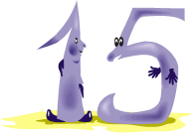
Numbers 11-20
iHdaa 3ashar
sittata 3ashar
ithnaa 3ashar
sab3ata 3ashar
thalaathata 3ashar
thamaaniyata 3ashar
arba3ata 3ashar
tis3ata 3ashar
3ishruun
khamsata 3ashar

Slide 14
عُمْرِي أَرْبَعَةَ عَشَر سَنَة, وَأَنْتِ كَمْ عُمْرُكِ؟
3umrii arba3ata 3ashar sana, wa anti kam 3umruki?
My age is fourteen years, and you how old are you?
كَمْ عُمْرُكَ؟
kam 3umruka?
How old are you?

Slide 15
عُمْرِي ثلَاثة عَشَر سَنَة
3umrii thalaathata 3ashar sana
(My age is thirteen years)
I am thirteen years old

Slide 16
Now it is your turn
Kam 3umruka?
How old are you? (male)
Kam 3umruki?
How old are you? (female)

Slide 17








Countries= buldaan= بُلْدَان
اَلْمَغْرِب
almaghrib
Morocco
ابْرِيطَانْيَا
ibriiTaanyaa
Britain
مِصْر
miSr
Egypt
فَرَنْسَا
faransaa
France
اِيطَالْيَا
iiTaalyaa
Italy
اِسْبَانْيَا
isbaanyaa
Spain
أَمْرِيكَا
amriikaa
America
سُورْيَا
suuryaa
Syria

Slide 18
Nationality = jinsiyya = جِنْسِيَّة
Nationality (male)
Nationality (female)
English
maghribiyy
maghribiyya
Moroccan
miSriyy
miSriyya
Egyptian
ibriiTaaniyy
ibriiTaaniyya
British

Slide 19
Find the male and female nationality of the following countries. (Check your answers with your teacher)
Nationality (male)
Nationality (female)
English
Italian
Spanish
American
Syrian

Slide 20
City = madiina = مَدِينَة
askunu fii murraakush fii almaghrib.
murraakush madiina qariiba min agaadiir.
I live in Marrakesh in Morocco. Marrakesh is a city close to Agadir.
askunu fii aSwaan fii miSr.
aSwaan madiina ba3iida 3an alqaahira
I live in Aswan in Egypt.
Aswan is a city far from Cairo
Askunu fii uksfurd fii ibriiTaanyaa.
Uksfurd madiina qariiba min lundun wa ba3iida 3an maanshistir.
I live in Oxford.
Oxford is a city close to London and far from Manchester.

Slide 21
Key Words
madiina = city
fii = in
wa = and
qariiba min = close to
ba3iida 3an = far from
ayna = where
askunu = I live
taskunu = you live (male)
taskuniin = you live (female)

Slide 22
Translate the following sentences
- I live in Madrid in Spain. Madrid is a city far from Barcelona.
madriid – Madrid
barshaluuna - Barcelona
- I live in Damascus in Syria. Damascus is a city close to Hums.
dimashq – Damascus
HumS - Hums
- I live in Paris in France. Paris is a city close to Nantes and far from Nice.
Naant – Nantes
niis - Nice

Slide 23
مِنَ الْمَغْرِب, أَنَا مَغْرِبِيّ. مِنْ
أَيْنَ أَنْتِ؟
min almaghrib, anaa maghribiyy. min ayna anti?
From Morocco, I am Moroccan. Where are you from?
أَنْتَ مِنْ أَيْنَ؟
anta min ayna?
Where are you from?

Slide 24
أَسْكُنُ في مراكش في الْمَغْرِب
. وأنْتِ أَيْنَ تَسْكُنِين؟
askunu fii murrakush fii almaghrib. wa anti, ayna taskuniin?
I live in Marrakesh in Morocco. And you, where do you live?
مِن ابريطانيا , أنا ابريطانية. أَيْنَ تَسْكُن؟
min ibriiTaanyaa, anna ibriiTaaniyya. ayna taskun?
from Britain, I am British. Where do you live?

Slide 25
أَسْكُن فِي مَانْشِسْتِر, مَدِينَة قَرِيبَة
مِنْ
بِرْمِنْغهَام وَبَعِيدَة عَن لُنْدُن.
askunu fii maanshistir, madiina qariiba min Birmingham wa ba3iida 3an lundun.
I live in Manchester, a city close to Birmingham and far from London.
مع السلامة!
ma3a-ssalaama
Goobye!

Slide 26
wa anta / anti, ayna taskunu / taskuniin?
And you, where do you live?

Slide 27
Put it all together
Task 1
Listen to the audio and correct the following statements.
1- it is morning
2- the person talking is called Mariam
3- She is fifteen years old
4- Mariam is Moroccan
Task 2
Pair up with a colleague and introduce each other in Arabic. (e.g. greeting, age…etc.)

Slide 28
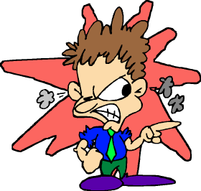
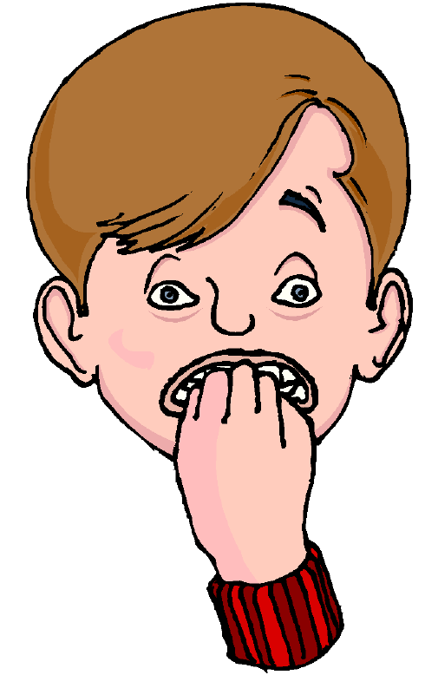
Homework
With the help of the joining letters sheet (from the previous lesson), try to handwrite the following sentences in the Arabic script and translate them into English. Your teacher will give you feedback on your writing.
Example:
I am Egyptian = (feminine)
anaa miSriyya =
أَنَا مِصْرِيَّة
3umrii khamsata 3ashar sana
ismii maark
anaa faransiyy
askunu fii madiinat maanshistir

