Slide 1
Module 2 Research and Library Skills Part 2 Assessing information from primary sources Advice on acceptable primary sources
Developed by Céline Benoit,
Aston University

Slide 2
Using the internet for research: How do I know if a website is reliable?
It is possible for anyone to create a website, and some websites, such as Wikipedia, can be updated by anyone. It is therefore important that you assess how reliable the information is.
Here are a few tips for checking how reliable the information is:
Look at the last time the website was updated; the website may be a reliable site but the information could be out of date
Look for information about the author; have they written any other published articles in this field, do they have relevant qualifications?
Check the extension of the website, for example .gov (government), edu. (educational), .mil (military) are controlled sites and therefore reliable. The extensions .com, .org, and .net can be purchased by anyone so your assessment of their reliability will need to be more thorough

Slide 3
Activity
Find three reliable websites about education (in England or in Europe).

Slide 4
Examples of reliable websites
Website | Reliability
www.england.edu/ | .edu is a reliable extension however the information has not been updated recently
www.education.gov.uk | Reliable extension and up to date information
www.education.gouv.fr | As above
www.enseignementsup-recherche.gouv.fr | As above
www.educationuk.org | Although the extension is .org, the author of the site is the British Council
www.guardian.co.uk/education | As above however note that the information can be subjective

Slide 5
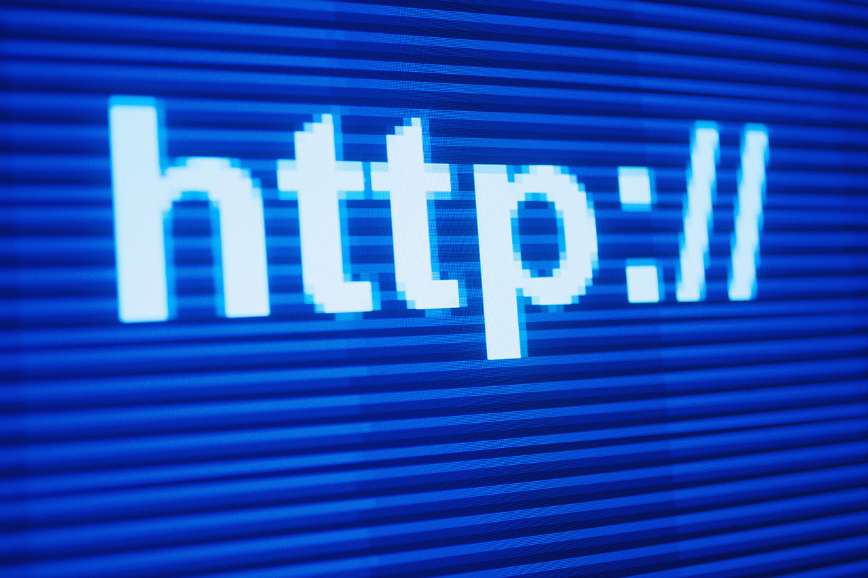
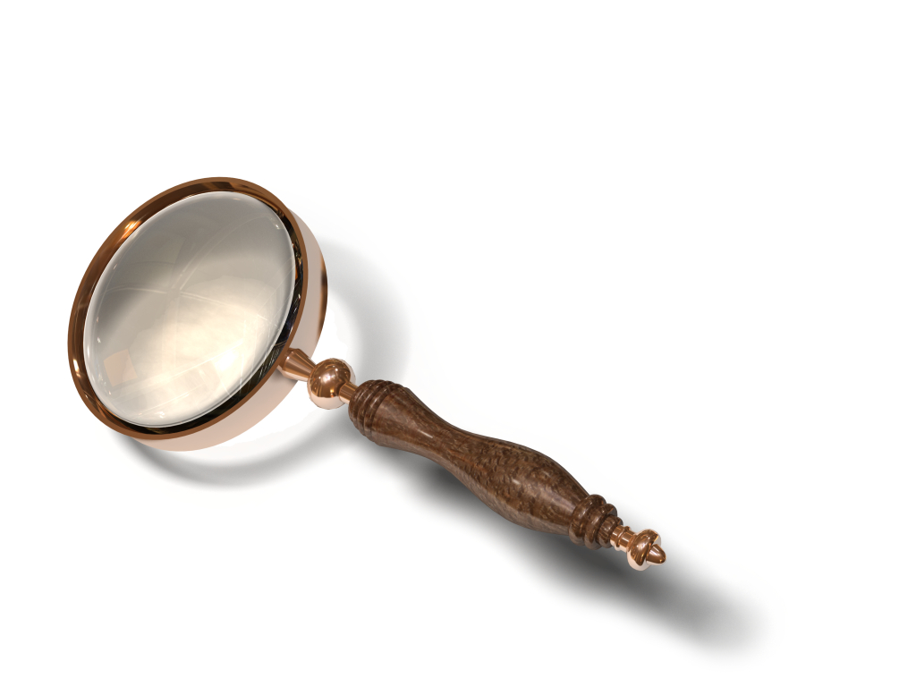
Internet Activity
To further test your internet skills, visit:
http://www.vtstutorials.ac.uk/detective/brief.html

