Slide 1
Lesson ten
Cities and travelling

Slide 2
Lesson objectives
In this lesson we will learn…
A few words for cities
A few words for tourist attractions
To use a question word ‘where’
a few sentence patterns
A few more characters

Slide 3
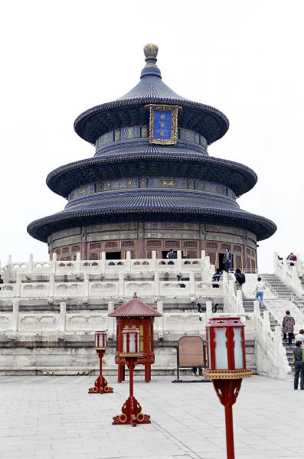

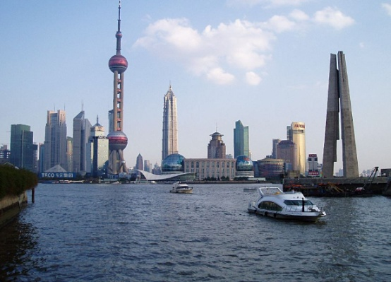
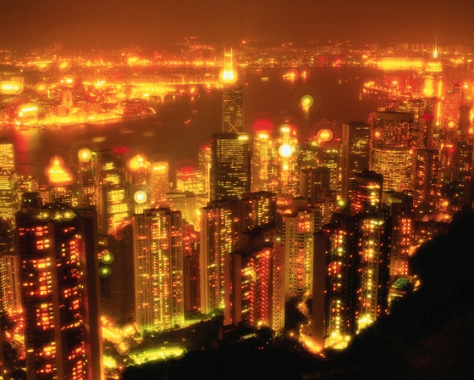
chéngshì city
Běijīng
Shànghǎi
Xiānggǎng
Hongkong

Slide 4
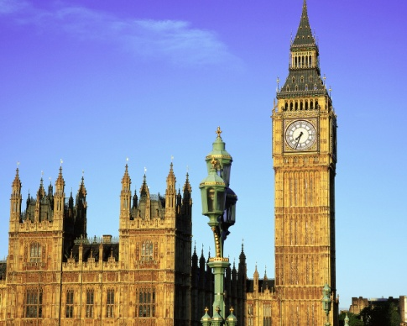
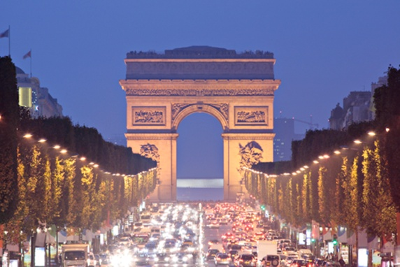
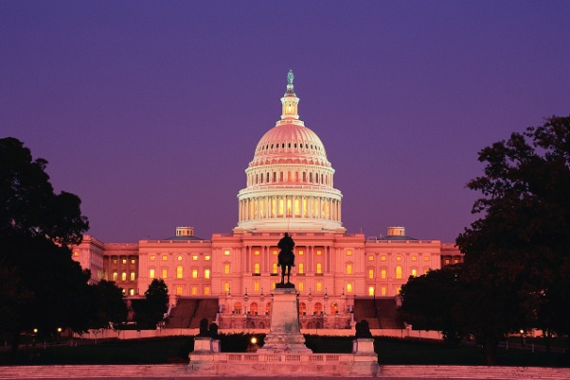
chéngshì city
Lúndūn
London
Bālí
Paris
Huáshèngdùn
Washington

Slide 5




Do you remember how to say these counties?
Zhōng guó
Yīng guó
Fǎ guó
Měi guó

Slide 6
Do you know the capitals of these counties?
Lúndūn
London
Běijīng
Huáshèngdùn
Washington
Bālí
Paris

Slide 7
Which city is it?

Slide 8
Question word ‘nar’
Nǐ dǎsuàn qù nǎr?
Where do you plan to go?
Wǒ dǎsuàn qù Bālí.
I plan to go to Paris.

Slide 9
Tell each other where you plan to go this summer holiday using the following sentence structures
Jīnnián shǔjià nǐ dǎsuàn qù nǎr?
Where do you plan to go this summer holiday?
Jīnnián shǔjià wǒ dǎsuàn qù…
This summer holiday I plan to go to…

Slide 10
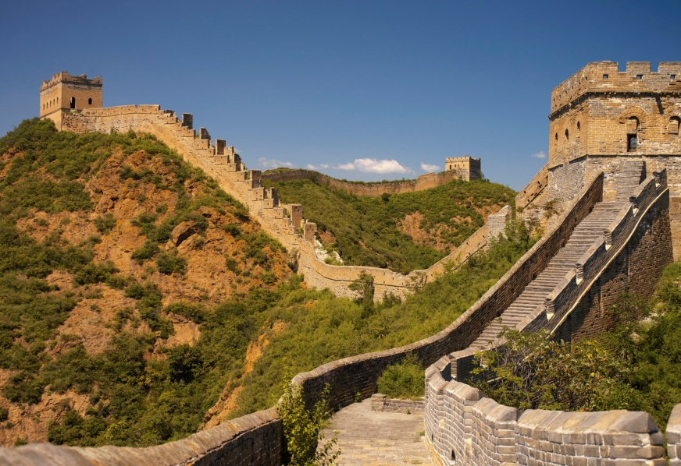
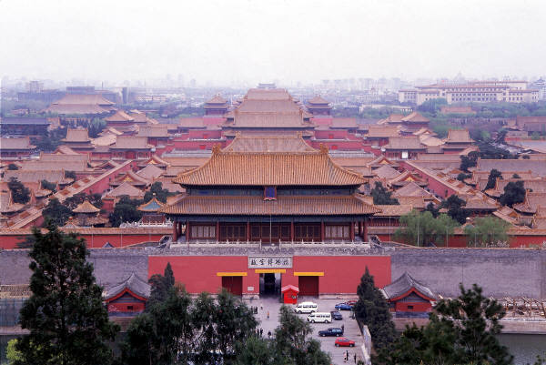
Tourist attractions
chángchéng
Great Wall of China
gùgōng
Forbidden City

Slide 11
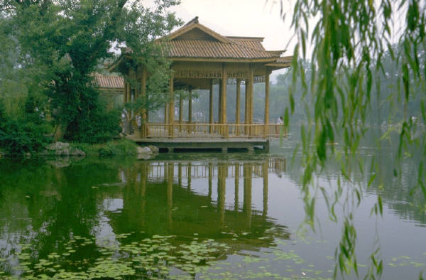
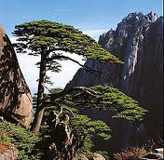
Tourist attractions
xīhú
West Lake
huángshān
Yellow Mountain

Slide 12
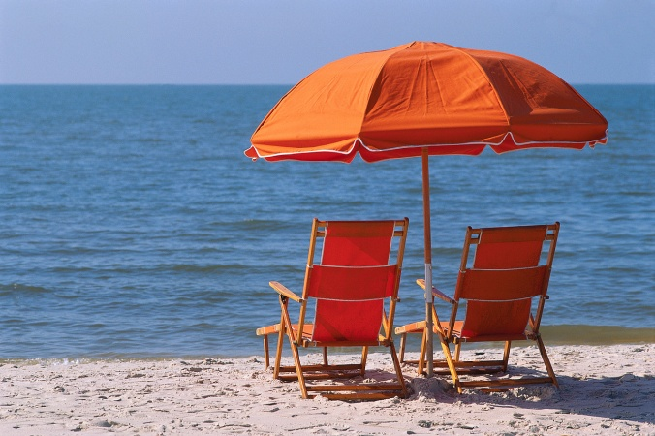
Tourist attractions
bówùguǎn
museum
hǎitān
beach

Slide 13
Tourist attractions
dòngwùyuán
zoo
gōngyuán
park

Slide 14
Where is it?

Slide 15
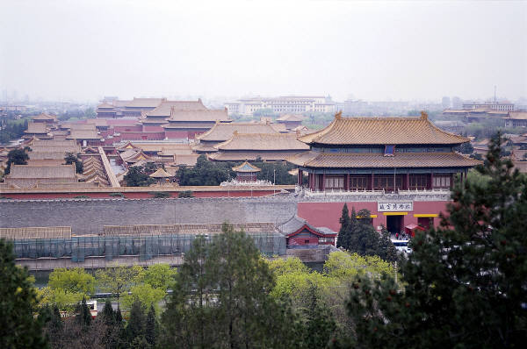
Tell each other where you want to visit if you travel to China using the following sentence structure
Wǒ xiǎng qù…
I want to go to…
For example
Wǒ xiǎng qù gùgōng.
I want to go to the Forbidden City.

Slide 16
Read the following passage and answer the questions
Wǒ jiào Měiměi, shì Yīngguórén. Jīnnián shǔjià wǒ dǎsuàn zuò fēijī qù Zhōngguó. Wǒ xiǎng qù chángchéng hé gùgōng. Chángchéng hé gùgōng zài Běijīng. Wǒ yě xiǎng qù Běijīng de bówùguǎn hé dòngwùyuán.
Questions:
1. Who is Meimei?
2. What does Meimei plan to do?
3. Where does she want to visit?

Slide 17
Answers
1. Meimei is British.
2. Meimei plans to take plane to China this summer
holiday.
3. Meimei wants to visit the Great Wall of China
and the Forbidden City, and she also wants to go
to museums and zoos in Beijing.

Slide 18
Characters
北京 Běijīng Beijing
公园 gōngyuán park
动物园 dòngwùyuán zoo

Slide 19
Conclusion
In today’s lesson we have learnt…
words for cities, such as ‘Beijing’, ‘Shanghai’, ‘Xianggang’, ‘Lundun’, ‘Bali’ and ‘Huashengdun’;
words for tourist attractions, such as ‘gugong’, ‘changcheng’, ‘xihu’, ‘huangshan’, ‘bowuguan’, ‘haitan’, ‘dongwuyuan’ and ‘gongyuan’;
to use question word ‘nar’;
a few sentence patterns;
a few more characters.

