Slide 1
Lesson nine
Transport

Slide 2
Lesson objective
In today’s lesson we will learn…
words for transport;
a few verbs, such as ‘take’, ‘ride’ and ‘go’;
a question word – how;
a sentence pattern;
a few characters.

Slide 3


Transport
jiàochē
car
kāi chē
Drive (car)

Slide 4
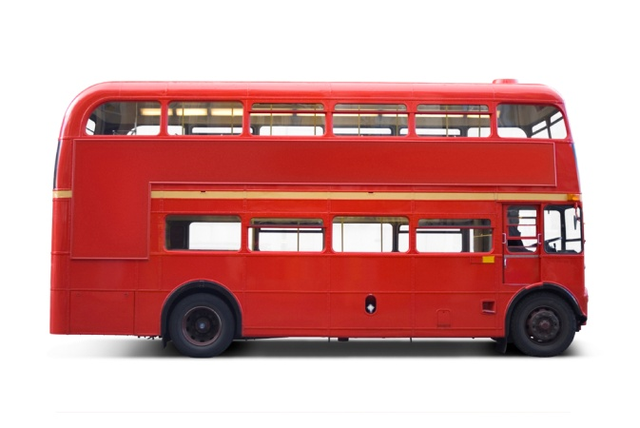
gōnggòng qìchē
bus
zuò qìchē
take bus

Slide 5
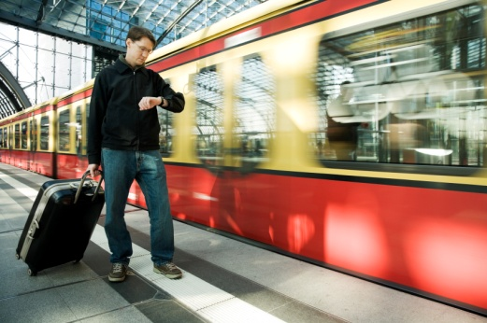
huǒchē
train
zuò huǒchē
take train

Slide 6

fēijī
plane
zuò fēijī
take plane

Slide 7
zìxíngchē
bicycle
qí chē
ride bike

Slide 8
zǒu lù
walk
qí mǎ
ride horse

Slide 9
What are these?

Slide 10
What are they doing?

Slide 11

Use question word ‘zenme’
Sentence pattern
Nǐ zěnme qù…?
How do you go to…?
For example
Nǐ zěnme qù xuéxiào?
How do you go to school?

Slide 12

Do you remember how to say these places in Chinese?

Slide 13
Can you ask questions using ‘zenme’?

Slide 14

Sentence pattern
Subject + transport + go + place
For example
Wǒ zuò qìchē qù xuéxiào.
I take bus to school.
Wǒ zuò huǒchē qù Lúndūn.
I take train to London.

Slide 15
Practice the sentence pattern using the following pictures

Slide 16

Listen to the following sentences and match the pictures

Slide 17
A few characters
坐 zuò sit/take
火车 huǒchē train
自行车 zìxíngchē bicycle
去 qù go
飞机 fēijī plane

Slide 18
Conclusion
In this lesson we have learnt…
words for transport, such as ‘car’, ‘bus’, ‘train’, ‘plane’, ‘bicycle’;
a few verbs, such as ‘take’, ‘drive’, ‘ride’, ‘walk’, ‘go’;
to use the question word ‘zenme’ as in ‘how do you go to…?’;
a sentence pattern;
a few more characters.

