Slide 1
Lesson seven
Places and directions

Slide 2
Lesson objectives
In this lesson we will learn…
words for places
words for directions
a few sentence patterns
to use question word ‘where’
to write a few characters

Slide 3

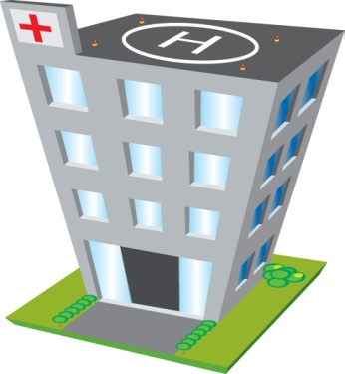
places
school xuéxiào
Can you remember these words?
restaurant cāntīng
hospital yīyuàn

Slide 4
places
pharmacy yàodiàn
Can you remember these words?
book shop shūdiàn
hair salon
lǐfàdiàn

Slide 5
places
train station huǒchēzhàn
Can you remember these words?
bus station qìchēzhàn
airport
fēijīchǎng

Slide 6
Can you say the places in Chinese?

Slide 7

Sentences
What place is this?
Zhè shì shénme dìfang ？
This is the Great Wall.
Zhè shì chángchéng.
chángchéng.

Slide 8
What place is this?

Slide 9
directions
běibiān
xībiān
dōngbiān
nánbiān

Slide 10
directions
zuǒbiān
yòubiān

Slide 11
Translate the English words into Chinese
West
North
East
South
Right
Left

Slide 12
Sentence
Where is …
… zài nǎr?
For example
Where is school?
Xuéxiào zài nǎr?

Slide 13
Practice question ‘where is…?’

Slide 14
Sentence patterns
1. Subject + zai + direction
2. Subject + zai + object + direction
For example
1. School is in the north.
Xuéxiào zài běibiān.
2. School is to the north of the book shop.
Xuéxiào zài shūdiàn de běibiān.

Slide 15

Answer the question ‘where is…?’

Slide 16
Listen to the following sentences, and point out directions

Slide 17
Check your answers
School is in the south.
Pharmacy is to the north of the hair salon.
Restaurant is in the east.
Hospital is to the west of the book shop.
Train station is to the left of the school.
Bus station is to the right of the hospital.

Slide 18
Write a few characters
East 东 dōng
south 南 nán
west 西 xī
north 北 běi
left 左 zuǒ
right 右 yòu

Slide 19
Conclusions
Today we have learnt
words for places, such as school, restaurant, hospital, pharmacy, book shop, hair salon, airport, bus station, train station;
words for directions, such as north, south, east, west, left, and right;
sentences, such as ‘where is…?’, ‘what place is this?’, ‘this is…’;
a few characters

