Slide 1
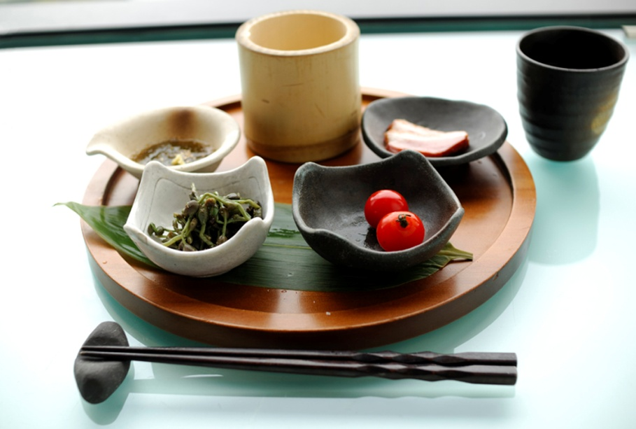
Lesson six
Food and drinks

Slide 2
Lesson objectives
Today we will learn…
words for drinks,
words for food,
to use verbs ‘chi’, ‘he’ and ‘xihuan’,
to order food and drinks,
to write a few Chinese characters.

Slide 3


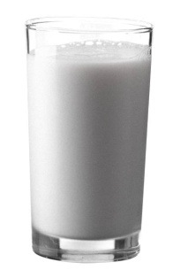

Drinks
shuǐ
water
niúnǎi
milk
kělè
cola
kāfēi
coffee
chá
tea
guǒzhī
juice

Slide 4
What are these?

Slide 5
What do you like to drink?
xǐhuan hē
like drink
Nǐ xǐhuan hē shénme ？
What do you like to drink?
Wǒ xǐhuan hē chá 。
I like to drink tea.

Slide 6
Tell us your favourite drinks
Wǒ xǐhuan hē…

Slide 7
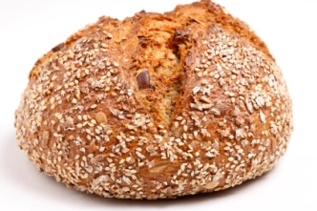
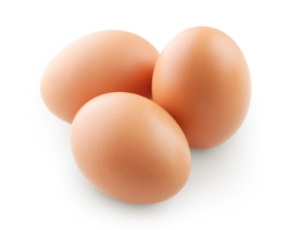
Food
miànbāo
bread
jīdàn
egg
yú
fish
hànbǎo bāo
hamburger
shǔ tiáo
chips
bǐsà bǐng
pizza

Slide 8
What are these?

Slide 9
miàntiáo
noodles
chūnjuǎn
spring roll
kǎoyā
roast duck
huǒ guō
hotpot
jiǎozi
dumpling
mǐfàn
cooked rice

Slide 10
What are these?

Slide 11
What do you like to eat?
chī
eat
Nǐ xǐhuan chī shénme ？
What do you like to eat?
Wǒ xǐhuan chī kǎoyā 。
I like to eat roast duck.

Slide 12
Tell us your favourite food
Wǒ xǐhuan chī…

Slide 13
Listen to the following sentences and decide weather the statements are true (T) or false (F)
I like to eat fish. ( )
I like to drink coffee. ( )
I do not like to eat noodles. ( )
Do you like to drink milk? ( )
I do not like to drink juice. ( )

Slide 14
Listening script and answers
Wǒ xǐhuan chī kǎoyā 。
I like to eat roast duck.
Wǒ xǐhuan hē kāfēi 。
I like to drink coffee.
Wǒ bù xǐhuan chī mǐfàn 。
I do not like to eat cooked rice.
Nǐ xǐhuan hē niúnǎi ma ？
Do you like to drink milk?
Wǒ bù xǐhuan hē chá 。
I do not like to drink tea.
1. F 2. T 3. F 4. T 5. F

Slide 15
Order food and drinks
yào…, hái yào…
want…, also want…
Nǐ diǎn shénme ？
What would you like to order?
Wǒ yào miàntiáo hé kǎoyā, wǒ hái yào shuǐ 。
I would like to order noodles and roast duck, and I also would like some water.

Slide 16
Can you order something to eat and to drink?

Slide 17
Learn some characters
Water 水 shuǐ
Tea 茶 chá
Coffee 咖啡 kāfēi
Juice 果汁 guǒzhī
Milk 牛奶 niúnǎi

Slide 18
Conclusion
Today we have learned…
words for drinks, such as water, tea, coffee, milk, juice, cola;
words for food, such as bread, egg, fish, hamburger, chips, pizza, noodle, rice, hotpot, spring roll, roast duck, dumpling;
verbs ‘chi’, ‘he’, ‘xihuan’;
to order food and drinks using ‘dian’, ‘yao…, hai yao…’;
a few characters.

