Slide 1
Lesson four
Time and date

Slide 2
Lesson objectives
Today we will learn…
how to say date and time;
to make questions with ‘ji’;
to talk about daily routine;
to write a few Chinese characters.

Slide 3

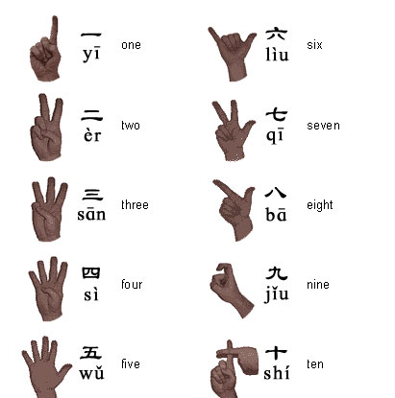
Do you remember the numbers?
liù
jiŭ

Slide 4
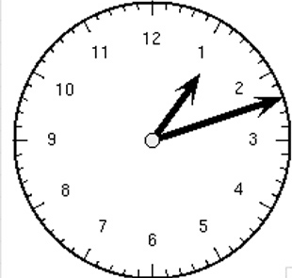
How to say time
diǎn fēn
o’clock minute
For example:
1:12
yī diǎn shí èr fēn

Slide 5
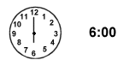
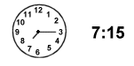
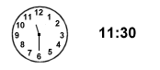
More examples
liù diǎn
qī diǎn shí wǔ fēn
qī diǎn yī kè
shí yī diǎn sān shí fēn
shí yī diǎn bàn

Slide 6
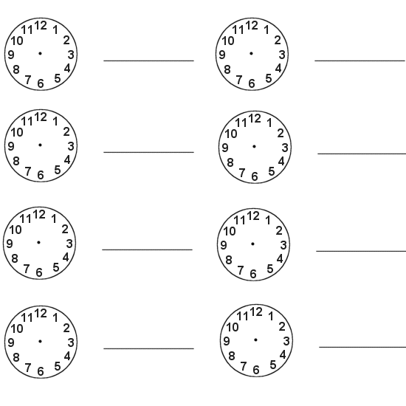
Make up a time on each clock and write the time down in pinyin
Notes:
http://www.google.co.uk/imgres?q=clock+maths&um=1&hl=en&lr=&safe=active&rlz=1T4LENN_enGB444GB444&biw=1366&bih=566&tbm=isch&tbnid=BjKHY6TTP2Yb5M:&imgrefurl=http://www.brobstsystems.com/kids/blankclock.htm&docid=T0P6FqMlIFQ3JM&imgurl=http://www.brobstsystems.com/kids/images/blankclock.gif&w=550&h=550&ei=95kiT6nQBsO28QOrkpG6Bw&zoom=1&iact=hc&vpx=285&vpy=120&dur=12899&hovh=224&hovw=224&tx=109&ty=146&sig=109744370519676043686&page=1&tbnh=109&tbnw=109&start=0&ndsp=26&ved=1t:429,r:1,s:0

Slide 7
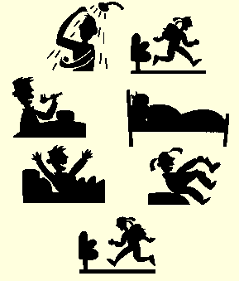
Some words for daily routine
qǐ chuáng
chī fàn
shuì jiào
Notes:
http://www.google.co.uk/imgres?q=daily+routine+pictures&um=1&hl=en&sa=N&rlz=1T4LENN_enGB444GB444&biw=1366&bih=566&tbm=isch&tbnid=RfbA0P21b_0WbM:&imgrefurl=http://englishdomination.wordpress.com/2010/03/08/vocabulary-family-daily-routines/&docid=XFw0Tei1HVSc8M&imgurl=http://englishdomination.files.wordpress.com/2010/03/dailyrou.gif&w=289&h=339&ei=f6YiT6-CEYOq8QOM983eBw&zoom=1&iact=hc&vpx=298&vpy=153&dur=8964&hovh=243&hovw=207&tx=100&ty=105&sig=109744370519676043686&page=5&tbnh=160&tbnw=130&start=72&ndsp=21&ved=1t:429,r:1,s:72

Slide 8
To talk about daily routine
I get up at 8:00.
Wǒ bā diǎn qǐ chuáng。
I eat meal at 8:30.
Wǒ bā diǎn bàn chī fàn。
I go to bed at 22:00.
Wǒ èr shí èr diǎn shuì jiào。

Slide 9
How to say date
January
February
March
April
May
June
July
August
September
October
November
December
yī yuè
èr yuè
sān yuè
sì yuè
wǔ yuè
liù yuè
qī yuè
bā yuè
jiǔ yuè
shí yuè
shí yī yuè
shí èr yuè

Slide 10
How to say date
nián yuè rì/hào
year month day
For example:
1st June 1994
yī jiǔ jiǔ sì nián liù yuè yī rì

Slide 11
To say your birthday
Birthday shēng rì
My birthday is…
Wǒ de shēng rì shì…
For example:
My birthday is the 8th May 1998.
Wǒ de shēng rì shì yī jiǔ jiǔ bā nián wǔ yuè bā rì.

Slide 12
Week days
Monday
Tuesday
Wednesday
Thursday
Friday
Saturday
Sunday
xīng qī yī
xīng qī èr
xīng qī sān
xīng qī sì
xīng qī wǔ
xīng qī liù
xīng qī rì

Slide 13
Use ‘ji’ to make questions
1. Xiànzài jǐ diǎn？
Now how many/much o’clock
What time is it now?
2. Jīntiān xīngqī jǐ？
Today week how many/much
What day is it today?
3. Míngtiān jǐ hào？
Tomorrow how many/much date
What is the date tomorrow?
4. Nǐde shēngrì shì jǐ hào？
Your birthday is how many/much date
When is your birthday?
Can you answer these questions?

Slide 14
Possible answers to the questions
1. Xiànzài bā diǎn.
Now eight o’clock
Now is eight o’clock.
2. Jīntiān xīngqī sì.
Today week four
Today is Thursday.
3. Míngtiān jiŭ hào.
Tomorrow nine date
Tomorrow is 9th.
4. Wŏde shēngrì shì jiŭ yuè shí hào？
My birthday is nine month ten date
My birthday is the 10th September.

Slide 15
Learn some characters
O’clock 点 diǎn
Minute 分 fēn
Half 半 bàn
Birthday 生日 shēng rì

Slide 16
Conclusion
Today we have learned…
to say time using ‘dian’ and ‘fen’;
to say date using ‘nian’, ‘yue’ and ‘ri/hao’;
to say week days;
to say birthday;
to talk about daily routine;
to make questions of time, date, and day with ‘ji’;
to write a few characters.

