Slide 1
Introduce yourself
Lesson two

Slide 2
Lesson objectives
In this lesson we will learn…
to say name, nationality and age
to count numbers from 1 to 99
to write ten numbers in characters

Slide 3

Do you still remember how to greet each other?

Slide 4
What is your name?
Nĭ jiào shénme?
My name is …
Wǒ jiào …

Slide 5
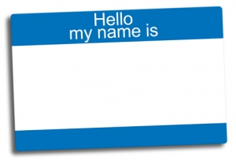
Listen to the recording

Slide 6
What is your nationality?
Nǐ shì nǎ guó rén?
I am British.
Wǒ shì yīng guó rén.

Slide 7




Zhōng guó rén
Zhōng guó
Yīng guó
Yīng guó rén
Fǎ guó
Fǎ guó rén
Měi guó
Měi guó rén

Slide 8

Listen to the sentences
Test yourself
Notes:
http://www.sodahead.com/fun/whats-your-nationality/question-259721/?page=2&link=ibaf&q=nationality&imgurl=http://images.sodahead.com/polls/000259721/polls_children_holding_hands_around_the_world_0602_261348_poll_xlarge.gif

Slide 9
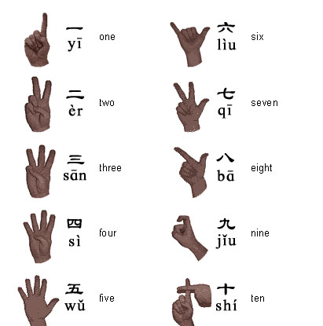
Numbers 1 to 10
liù
jiŭ
Notes:
http://www.google.co.uk/imgres?imgurl=http://www.chinahighlights.com/image/travelguide/guidebook/hand.jpg&imgrefurl=http://www.chinahighlights.com/travelguide/learning-chinese/chinese-number.htm&h=415&w=411&sz=24&tbnid=ogL8qyIkJthbVM:&tbnh=93&tbnw=92&prev=/search%3Fq%3Dchinese%2Bnumbers%26tbm%3Disch%26tbo%3Du&zoom=1&q=chinese+numbers&docid=oAePvSYkSm9C8M&hl=en&sa=X&ei=sXUZT6uRHYKV8gPXo5yuCw&sqi=2&ved=0CDYQ9QEwAg&dur=195

Slide 10
Can you say the following numbers in Chinese?
24, 36, 53, 68, 99, 75

Slide 11
How old are you?
Nǐ duō dà le?
I am 11.
Wǒ shíyī.

Slide 12
Can you talk about yourself?
Can you find out other persons’ personal details?
For example
My name is…
I am British/Chinese/…
I am 15/12/… years old.
What is your name?
What is your nationality?
How old are you?

Slide 13
Listen to the recording and answer the questions in Chinese
1. What is the speaker’s name?
2. What is her nationality?
3. How old is she?

Slide 14
Check your answers
1. Wǒ jiào Qiaochao.
2. Wǒ shì Zhōng guó rén.
3. Wǒ èr shí wŭ.

Slide 15
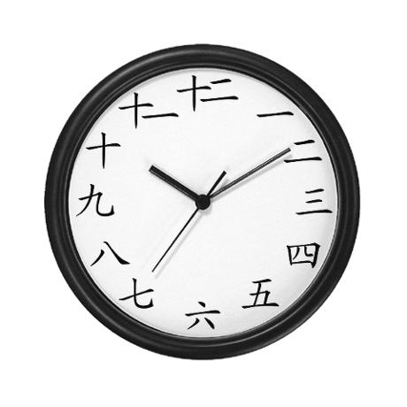
Learn to write characters from one to ten
Notes:
http://www.google.co.uk/imgres?q=chinese+numbers&um=1&hl=en&sa=N&rlz=1T4LENN_enGB444GB444&biw=1366&bih=566&tbm=isch&tbnid=uuzzLEsMz9zMEM:&imgrefurl=http://www.cafepress.com/%2Bchinese_numbers_wall_clock,487457714&docid=D5FdA83nFimIXM&imgurl=http://images4.cpcache.com/nocache/product/487457714v2147483647_460x460_Front.jpg&w=460&h=460&ei=FH0ZT4XXBc6X8gOY6425Cw&zoom=1&iact=hc&vpx=1098&vpy=180&dur=2829&hovh=225&hovw=225&tx=137&ty=172&sig=109744370519676043686&page=13&tbnh=175&tbnw=195&start=204&ndsp=15&ved=1t:429,r:9,s:204

Slide 16
Conclusion
Today we have learned
to say ‘my name is…’
‘I am Chinese/…’
‘I am 12/…’
to ask questions such as
what is your name?
what is your nationality?
how old are you?
to count from 1 to 99
to write from 1 to 10 in characters.

