Slide 1
Greetings
Hello! Assalam-o-alaikum!
السلام علیکم
(reply) Walaikum – Assalam!
و علیکم السلام

Slide 2
What will we learn today?
اردو Urdu
Food and Drink (Khana Peena)
To be able to say some basic greetings in Urdu (hello, what is your name, etc.)
To be able to say and remember some basic words and phrases for food and drink and to create a menu for your school.
To have fun!

Slide 3
What is your name?
Aap ka naam kya hey?
آپ کا نام کیا ہے
My name is……
Mera naam……. Hey
میرا نام۔۔۔۔۔۔۔۔۔۔۔ہے

Slide 4
Bye!
Allah Hafiz!
Or
Khuda Hafiz! خدا حافظ

Slide 5
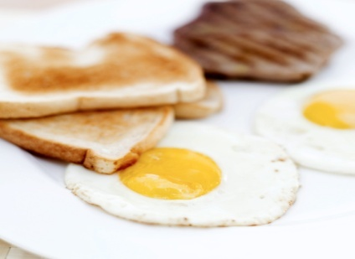
Food and Drink (Khana Peena)
Nashta (breakfast)
Double Roti (bread/toast)
Anda (egg)

Slide 6

Chai (tea)

Slide 7
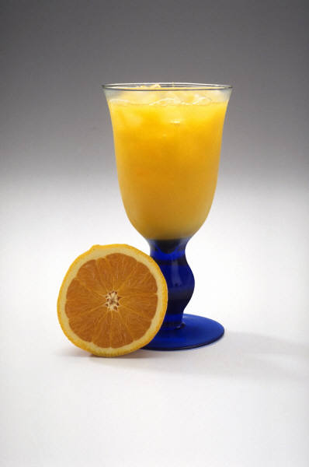
Narangi ka ras / juice

Slide 8
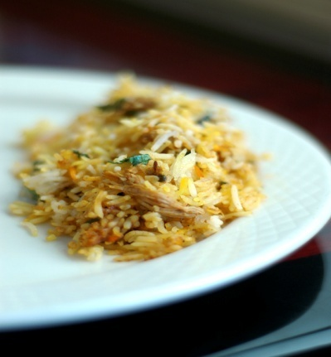
Dupehr ka khaana (lunch)
Or
Raat ka khaana (dinner)
Pilau Rice / Biryani

Slide 9
Dupehr ka khaana (lunch)
Or
Raat ka khaana (dinner)
Seekh Kebab

Slide 10
Dupehr ka khaana (lunch)
Or
Raat ka khaana (dinner)
Shorba (chicken casserole)

Slide 11
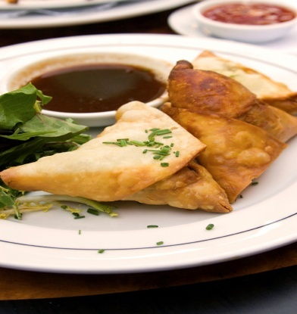
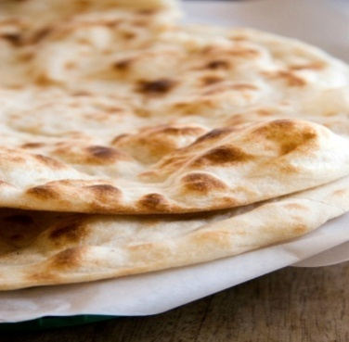
Dupehr ka khaana (lunch)
Or
Raat ka khaana (dinner)
Samosa Roti

Slide 12
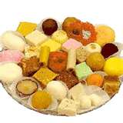
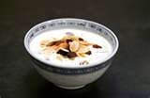
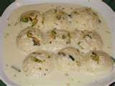
Desserts
Kheer (rice pudding)
Mithai (sweetmeats)
Rasmalai

Slide 13
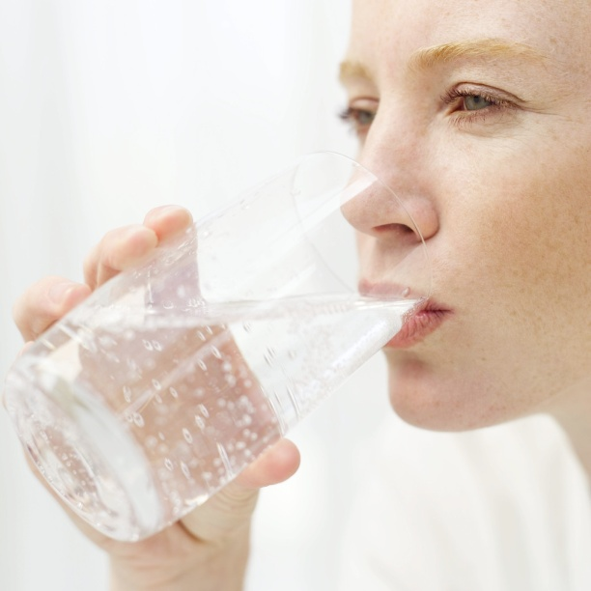
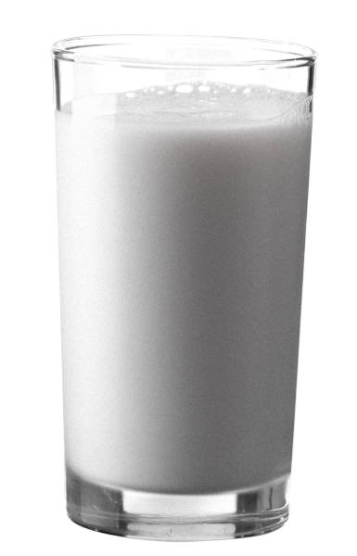
Drinks
Paani (water)
Chai (tea) Doodh (milk)

Slide 14
Let’s see if you can remember?
Dupehr ka khaana
(lunch)
Raat ka khaana
(dinner)

Slide 15


Let’s see if you can remember?
Nashta
Chai
Narangi ka ras / juice
Doodh
Paani

Slide 16
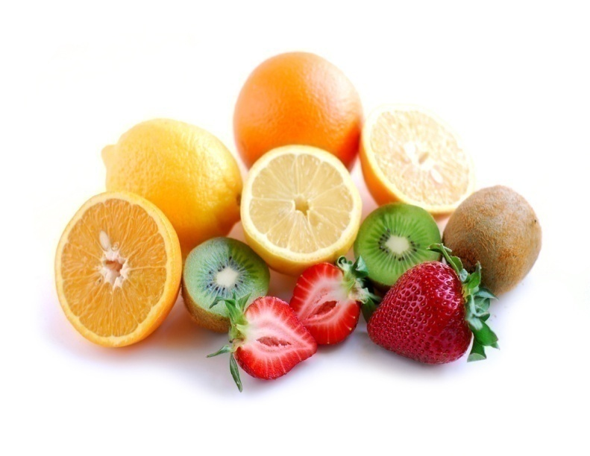




Phall (fruit)
Kela (banana)
Angoor (grapes)
Seyb (apple)
Narangi (orange)
Ananas (pineapple)

Slide 17

Let’s see if you can remember?
Phall (fruit)

Slide 18
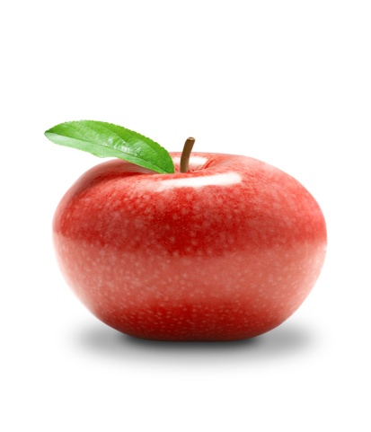
Let’s see if you can remember?
Ananas (pineapple)
Angoor (grapes)
Narangi (orange)
Seyb (apple)
Kela (banana)

Slide 19
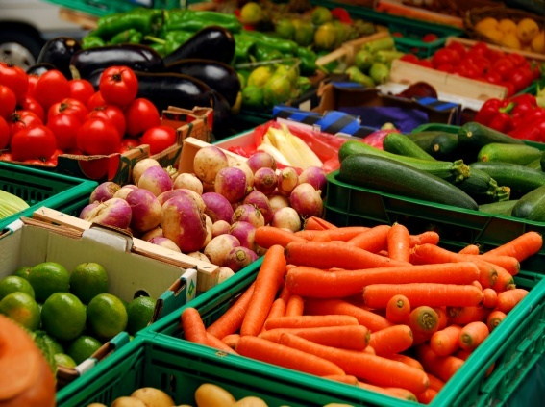
Let’s see if you can remember?
Sabzi

Slide 20

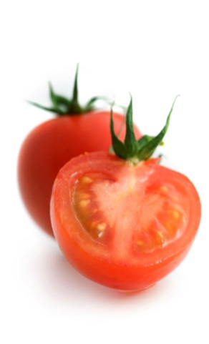
Sabzi (vegetables)
Leemu
Gaajar
Kheera
Tamaatar

Slide 21
Sabzi (vegetables)
Gaajar
Tamaatar
Leemu
Kheera

Slide 22
Desserts
Kheer (rice pudding)
Mithai (sweetmeats)
Rasmalai

Slide 23
Task
Your class has been asked to design a menu for the school, which
includes fruit and salads, main meals and drinks. For the salad,
you can choose which vegetables you would like.
Design a menu – make it as interesting as you can. The first example
is done for you. Remember it must all be in Urdu!

Slide 24
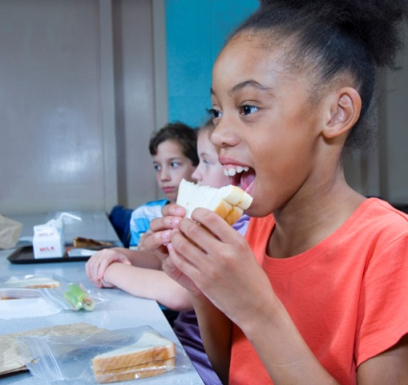
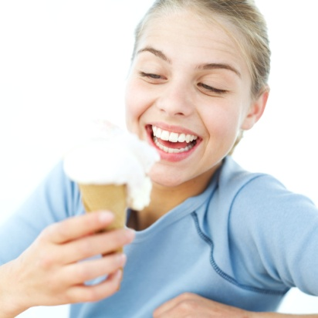
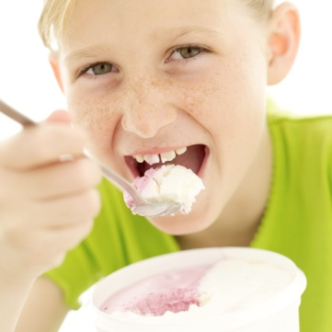
Menu
Monday
Narangi ka ras
Pilau
(gaajar, kheera)
Seyb
Rasmalai

